Slide 1


T
argeting
Your Transition
The Art and Science of making
Your Job Journey Successful
Sandy Lawrence PfMP, PgMP, PMP
Date: July 14 2020
Where: Suncoast Chapter PMI

Slide 2



Slide 3
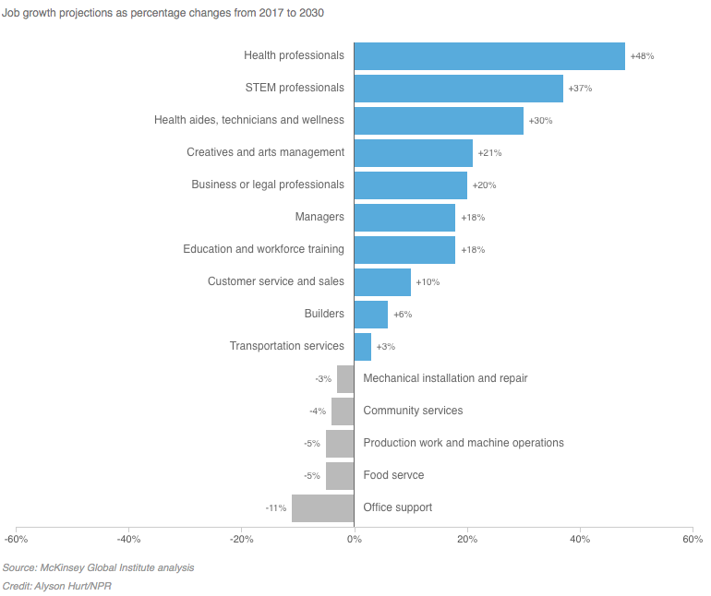
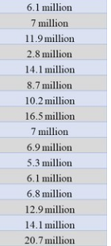
Transition Facts
Is your job safe?
40%
→ Job categories shrinking by 2030
Source: McKinsey Global Institute analysis/NPR

Slide 4
Transition Facts
"The pace of change will be so rapid
that people will learn 'in the moment'
using new technologies such as
augmented reality and virtual reality.
The ability to gain new knowledge will be more valuable than the
knowledge itself”…
Dell Corporation
4.6
→ average # years you stay at a job
12
→ # jobs average person has over their lifetime
50%
→ estimated # job changes occurring before age 25
Does your career path
get to retirement?
85%
→ jobs in 2030 don’t exist yet
Age group | Number jobs held
18-24
25-34
35-44
45-50
Source: Huffington Post, BLS

Slide 5

Transitional Thoughts
Where has your journey taken you?
Will your job/career path be here in the future
- and take you to retirement?
Do you like what you do?
Should/need/want to transition? Why?
Are you prepared to transition?

Slide 6


"The most successful people I know don't think of their career as a ladder. But rather, a jungle gym.”
Pattie Sellers, senior editor-at-large of Fortune magazine

Slide 7
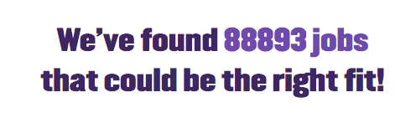



Slide 8

Filter and Focus
Industry
Role
Healthcare
Employee
IT
Owner
Financial
Contractor
Non-profit
Civil Servant
Manufacturing
Geography
Self
U.S.
Skills
Europe
Passion
Asia
Character
Leader
Family access
Salary
Manager
Benefits
Schools
Airport
Technical
Career Path
SME
Hospital
Academic
Retirement
Influence
Potential
Family

Slide 9



Filter and Focus
The World
Your Job World
Environment
Personal
Skills
Timing
Market

Slide 10
Transition steps
3-phase Approach
03
Pursuit
Search
Apply
Interview
Select
02
Next best job!
Targeting
Goals
Networking
Resume
01
Preparation
Readiness
Assessment
Charting
Roadmap
Reduce “Unknowns”

Slide 11
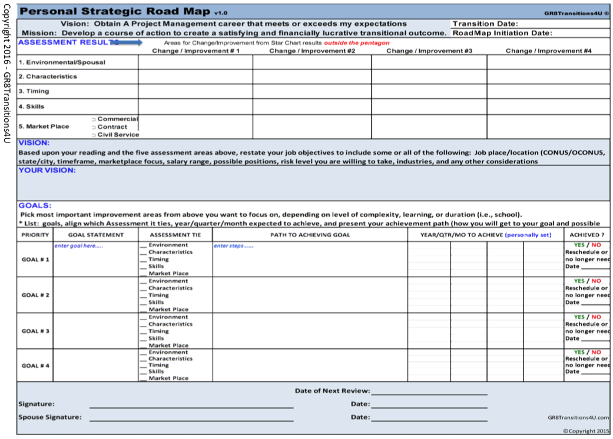
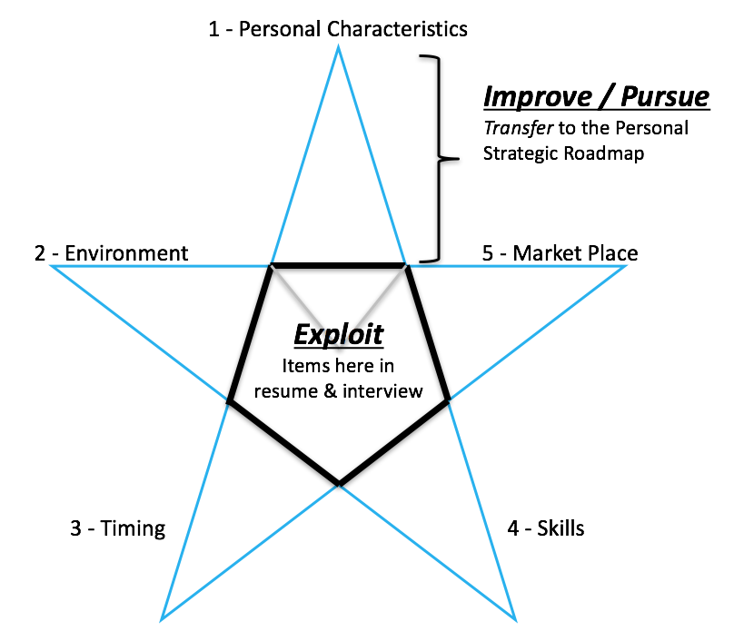
Phase 1: Readiness
Reduce the Unknowns
5 Assessments
Charting
Personal Targeted Roadmap
Reflect
Exploit
Achieve
Create Your Vision
Uncover Your Voice
Design Your Personal
Strategic Roadmap
How do I see myself now and
what do I want in work/life?
What are my strengths?
Where should I improve?
What do I need to move forward?

Slide 12

Phase 2: Targeting
Get Prepared
Goals and Objectives
Steps to success
Look and establish a mentor/coach!
Establish advisor / support
Time Management
Who to target?
Certification or Professional groups?
Geographic location
Volunteering and time investment
Networking
Resume ‘art and science’
Types and versions – which is best?
Represents your voice/brand?
Soft skills ‘resumeable’?
Resume

Slide 13
Phase 3: Pursuit !
Next Best Job!
Search
Search alternatives
Networking support
Vigilance and preparedness
Apply
Who to target?
Market research
Company research
Chopped resume
Preparation – corporate self reflection
Attitude, Behavior and Actions
STAR
Interview
Select
Benefits
Salary research and negotiation
Chemistry
Long-term path or transitional?

Slide 14
10 Reasons to change jobs
(because you want to)
Increase internal consulting skills / strength
Get good at spotting healthy vs. toxic workplaces -- and avoiding toxic ones
Powerful dragon-slaying stories
Network power frays and falls apart
Strengthen your brand
1 employer focus turns to internal politics. Get outside the cubicle
Know your market value
Pick up new protocol, procedures, strategies. Don’t get stale
Stay abreast of interview skills
Acquire thick skin – not everyone approves or loves you. Get appreciated for your talents!

Slide 15
Future Considerations
  3 skills that will count in the future:
  Learn how to access information – Stay current with technology to find information quickly, cheaply, effectively sorting what is true and what is not
  Learn to unlearn - People tend to learn certain skills and rules of thumb and then cling to them more rigidly as they grow older. It’s important to condition people that they have to be able to unlearn and start over, though that is a tall task.
  → PMI’s Organizational Transformation
  Survive in the gig economy - As more and more economic activity will be carried out by small independent operators, the ideas embedded in a corporate culture will become increasingly irrelevant. The corporation of the future will be a much looser association of various flexible, mostly small-scale, units.
The Atlantic & Joel Mokyr

Slide 16
Things to remember
When You Want to
into a new job
TRANSITION
Be Honest - discovering yourself can be uncomfortable, disenchanting, frustrating
Be Open-minded - Unexpected moves could take you to a place better than imagined
SMART Roadmap - set goals with objectives and follow them.
Define your goals - assess yourself to determine what you want and can achieve
The grass isn’t always greener on the other side
; it is green where you water it.

Slide 17

Thanks for Listening

Slide 18
About the Speaker – Sandy Lawrence
  Lots of Years Delivering Innovative Solutions ☺ (40+)
    Big 4 consulting, commercial, defense, entrepreneur
    Strategy, PMOs, Service Catalog, Portfolio, Program and Project Management
  PfMP® Certified– 26 Feb 2014 (#1715212)
  PgMP® Certified– 20 Mar 2009 (#1243712)
  PMP® Certified– 21 Jun 2005 (#233019)
  SSGB, ITILv3, ITIL SOA, ITIL OSA
  Active Community & PMI® Volunteer & Speaker
    PMI Betatest Micro-cert – Organizational Transformation I (2020) passed!
    Global and EMEA Conference Proposal Reviewer (both – 2020)
    PfMP Pilot, Panel Review, Item writing (2013 – present)
    PgMP Panel Review Team, Item writing (2012 – present)
    Military Liaison initiative (2014 – present)
    PMI WBS guide (2018)
    The Organization Project Management Advisory Group (OPM AG) (2014)
    Organizational Project Management: Guide – Vice Chair, First Edition (2013)
    Leadership Institute Master Class (LIMC) Graduate & Advisor – (2011 – 2013)
    PMI Tampa Bay Chapter Emeritus Board (2009 – present)
    VP Professional Services and PMP prep class trainer, Tampa Bay Chapter (2006-2008)
  Books Co-Authored (GR8Transitions4U)
    The Transitioning Military :
      Project Manager, 2015, 2020
      Logistician, 2015
      IT Professional, 2016
      Cybersecurity Professional, 2017
    The Transitioned Veteran (est. release, fall of 2020)

