Slide 1

May 10, 2016
Chapter Meeting

Slide 2

Tonight’s Agenda
Registration, Networking/Socializing, Light Snack
5:30-6:15 PM
Business Meeting / Announcements
6:15-6:30 PM
PM Workshop Activities
6:30-7:45 PM
Closing Remarks
7:45-8:00 PM
Making project management indispensable for business results.®

Slide 3
Vision
Local leadership and management embracing the PMI principles, values, and certifications as key components in organizational and individual success in the field of project management.
Mission
The PMI Florida Suncoast Chapter leads the local community in the advancement in the field of project management by promoting the PMI’s values and principles, as well as by organizing and facilitating events, activities, and initiatives to support individuals and organizations.

Slide 4

Making project management indispensable for business results.®

Slide 5
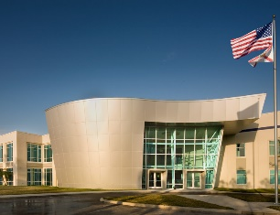
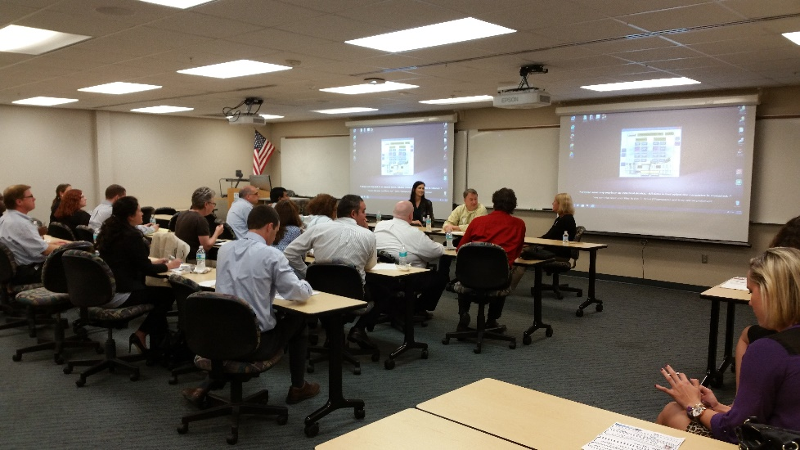
Chapter Meeting Venue
EpiCenter
at St. Petersburg College
Making project management indispensable for business results.®

Slide 6

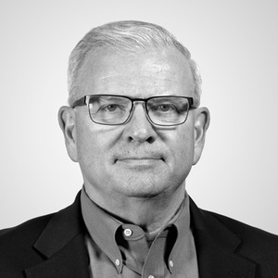
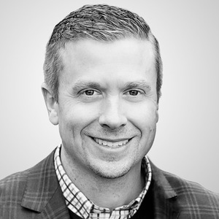
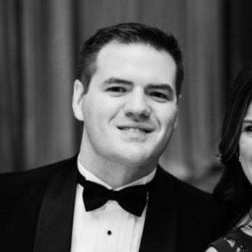
Meeting Sponsor
John Owens
John Larson
Steven Warneke
Making project management indispensable for business results.®

Slide 7
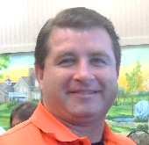

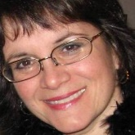
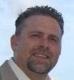
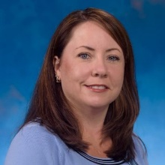
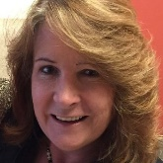
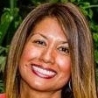
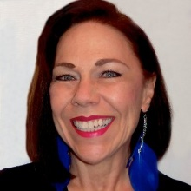
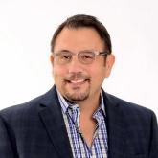
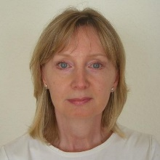

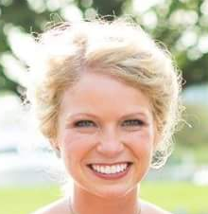
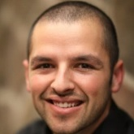
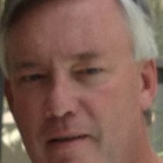
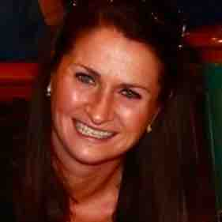
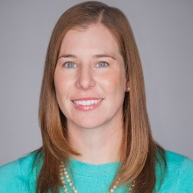
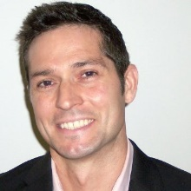
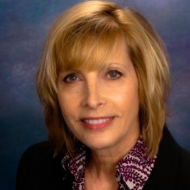
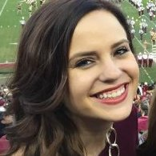
Board Members and Volunteer Leaders

Slide 8
New Members
and
Renewing Members

Slide 9

Making project management indispensable for business results.®

Slide 10
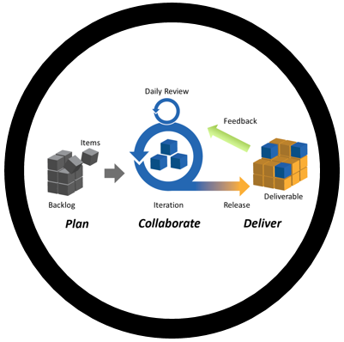
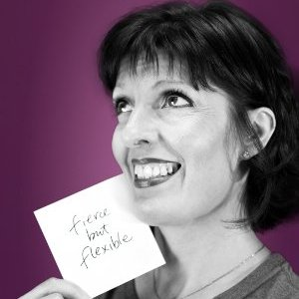
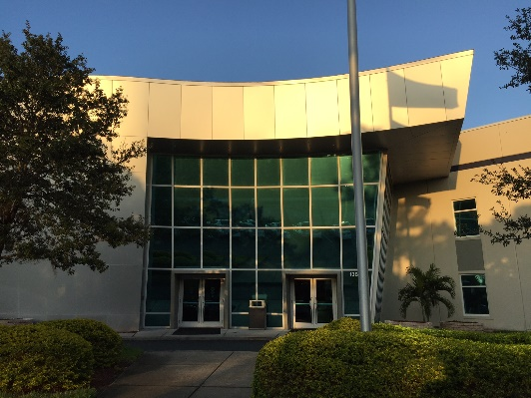


Future Meetings
A Different Way to
Meet and Collaborate
May 10th, 2016
Making project management indispensable for business results.®
Notes:
Cohesion is sponsoring tonight’s meeting.

Slide 11
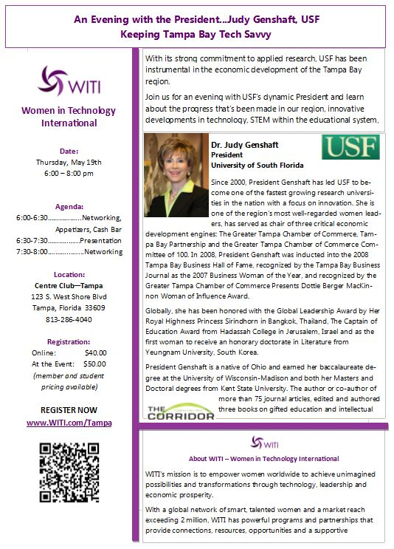
Future Partner Meeting
May 19, 2016
Making project management indispensable for business results.®
Notes:
This is a partner event that we are promoting.

Slide 12

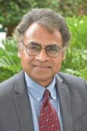
Future Meeting
Big Data Analytics
Not Just For Big Business
June 14, 2016
Dr. Anurag Argarwal
Information Systems Professor
University of South Florida - Sarasota
Making project management indispensable for business results.®
Notes:
Anurag Argarwal provided this presentation down in Sarasota and got rave reviews.

Slide 13

Future Meetings
Across the Bay Networking
July, 2016
Anthony Aguilar
VP of Special Projects
Making project management indispensable for business results.®

Slide 14
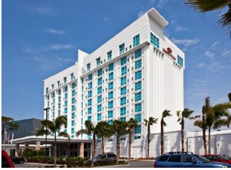


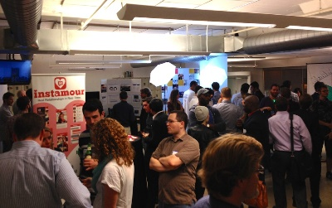
Future Meetings
Women in
Project Management
“Showcase”
August 23, 2016
Part Two of the
Two-Part Series
Crowne Plaza
5303 West Kennedy Blvd
Tampa, FL 33609
Making project management indispensable for business results.®

Slide 15

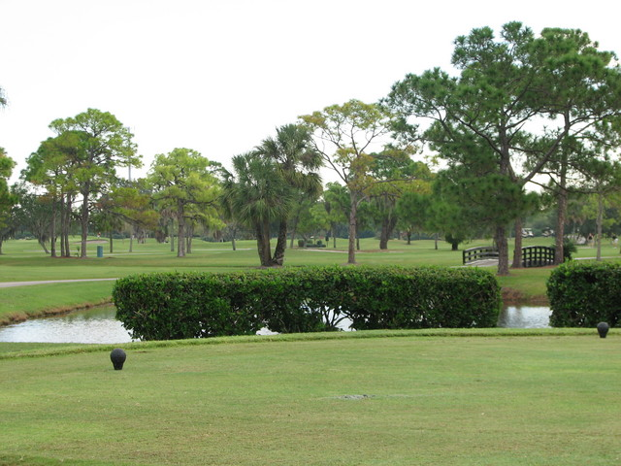


Future Meetings
Golf Outing
August 26, 2016
Looking for Players and Sponsors
Contact Bill Wagner for more details.
Making project management indispensable for business results.®

Slide 16








Future Meetings
How to Transition to Project Management and Why You Want To!
October or November, 2016
Leila Castellanos
VP of Membership
Making project management indispensable for business results.®

Slide 17





Future Events/Activities
Academic Outreach
Mentoring
Curriculum
Competitions
Exam Prep Classes
Student Membership
Kaitlyn Sussex
Initiative Leader
Making project management indispensable for business results.®

Slide 18



Future Events/Activities
PMI-PBA Study Group
Jameson Segler
Initiative Leader
Jameson.Segler@gmail.com
Making project management indispensable for business results.®
Notes:
Jameson Segler has volunteered to organize PMI-PBA Study Group as well as other exam-prep study groups.

Slide 19
Champions Program
and
PMO Leadership Summit
Contact
Initiative Leader scott McCance
Scott.McCance@PMI-FloridaSuncoast.org
Making project management indispensable for business results.®
Notes:
Another set of Initiatives kicking off are the Champions Program and the PMO Leadership Summit led by Scott McCance. Contact Scott if you have an interest in being involved or you know an organization that wants to be involved.

Slide 20
Guest Pass
Contact President Bill Wagner
William.Wagner@PMI-FloridaSuncoast.org
419.304.5012
Making project management indispensable for business results.®
Notes:
If you have not been a member of PMI Florida Suncoast Chapter and you are interested in becoming a member at no charge—saving $30.00—please contact Bill Wagner.

Slide 21

Get Involved!
Consider Volunteering!
Interaction with peers and mentors
Contribute value to PMI Florida Suncoast Chapter
Positive feelings
Sense of accomplishment
Contact Volunteer Leadership Chair Wendy Peacock
Wendy.Peacock@PMI-FloridaSuncoast.org
Making project management indispensable for business results.®

Slide 22
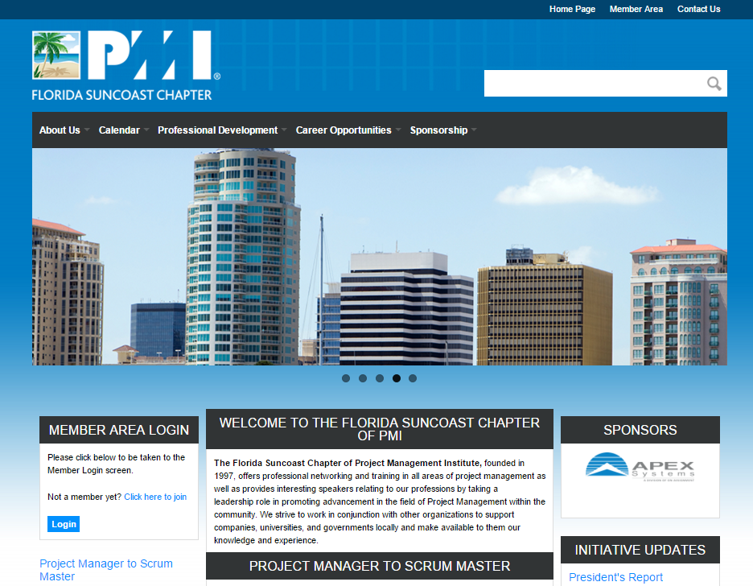
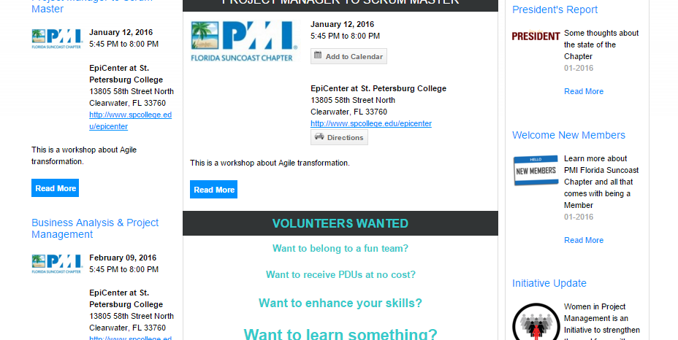
Check out our Web Site
www.suncoastpmi.org
Next Event
Other Upcoming Events
Initiative Updates

Slide 23
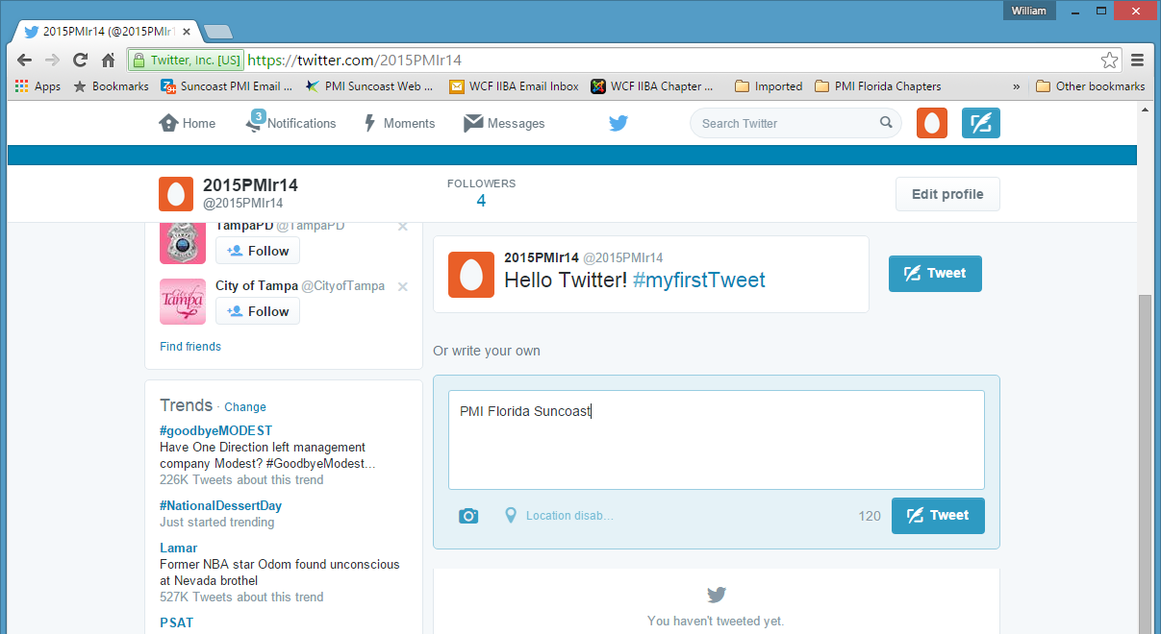
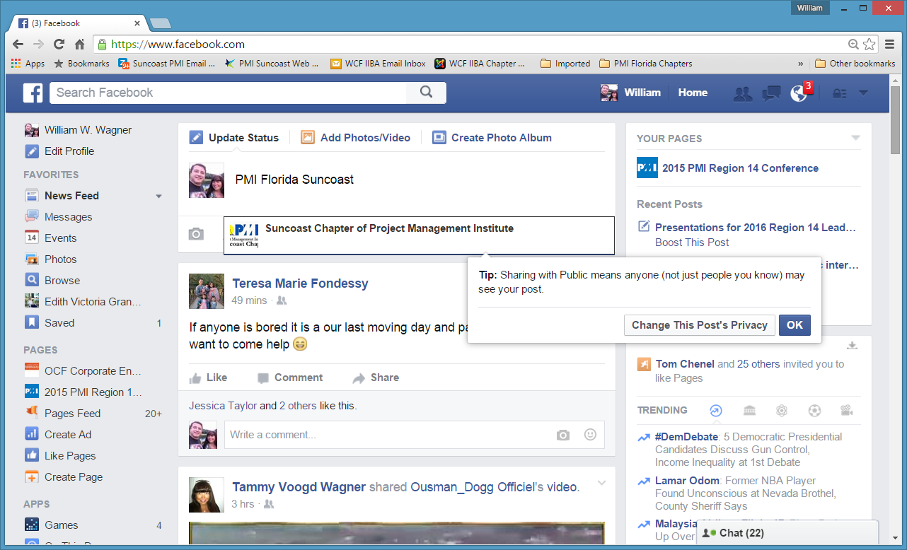
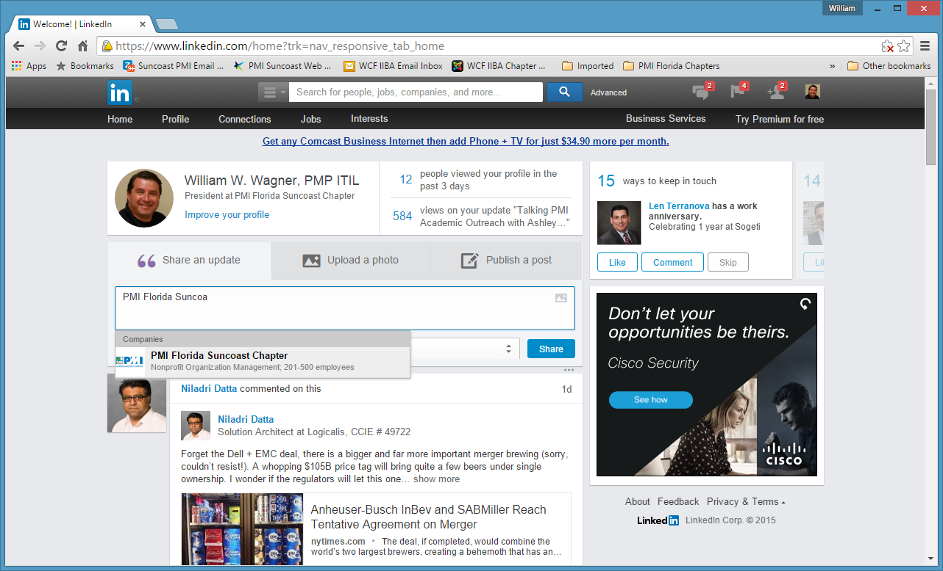
Use Social Media
#PMIFloridaSuncoast
Erica Woods
Initiative Leader
Making project management indispensable for business results.®

