Slide 1

May 10, 2016
Chapter Meeting

Slide 2
Vision
Local leadership and management embracing the PMI principles, values, and certifications as key components in organizational and individual success in the field of project management.
Mission
The Florida Suncoast PMI Chapter leads the local community in the advancement in the field of project management by promoting the PMI’s values and principles, as well as by organizing and facilitating activities to support individuals and organizations.

Slide 3

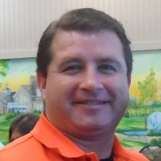
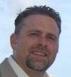
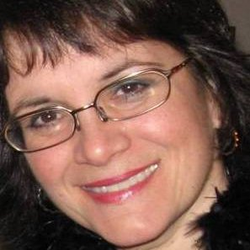

PMI Florida Suncoast Chapter
Board of Directors 2016-2017
Bill Wagner
President
Frank Coleman
VP of Finance
Janine Traycheff
VP of Administration
Wendy Peacock
Volunteer Leadership Chair
PMI Florida Suncoast
2

Slide 4
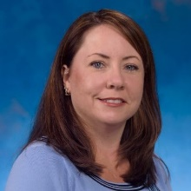
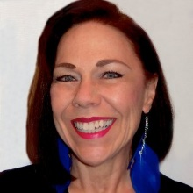
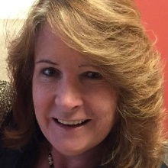
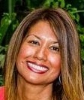
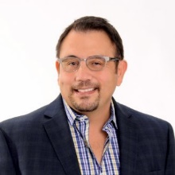
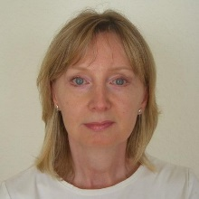
PMI Florida Suncoast Chapter
Board of Directors 2016-2017
Danita Downey
VP of Logistics
Catalina McChesney
VP of Communications
Carolyn Shope
VP of Marketing
Leila Castellanos
VP of Membership
Anthony Aguilar
VP of Special Events
Annemarie Wolfe
VP of Technology / E-Commerce
PMI Florida Suncoast
2

Slide 5
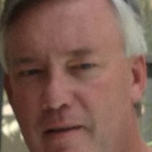
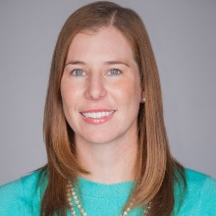
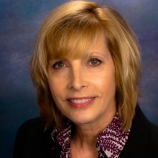
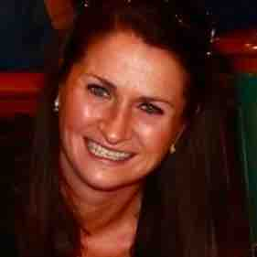
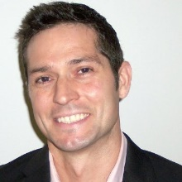
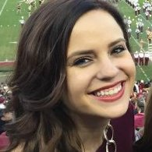

PMI Florida Suncoast Chapter
Volunteer Leaders 2016-2017
Scott McCance
Initiative Leader
Sarah Reper
Initiative Leader
Charlie Rogg
Initiative Leader
Erica Woods
Initiative Leader
Chris Matthews
Strategic Advisor
Kaitlyn Sussex
Initiative Leader
Jameson Segler
Initiative Leader
PMI Florida Suncoast
2

Slide 6
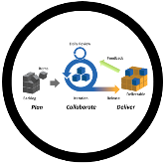



PMI Florida Suncoast Chapter
2016 Initiatives
Branding & Merchandising | Carolyn Shope
Special Events | Anthony Aguilar
Agile Inclusion | Frank Coleman
Volunteer Acquisition | Wendy Peacock
Business Analysis & Project Management | Bill Wagner
Membership Champions Program | Annemarie Wolfe
Volunteer Leadership Development | Wendy Peacock
Operations Policy Manual | Wendy Peacock
Micro Brewery Tour | Bill Wagner
Golf Outing | Bill Wagner
Military / Veteran Outreach | Leila Castellanos
Women in Project Management | Bill Wagner
PMI Florida Suncoast
2

Slide 7


PMI Florida Suncoast Chapter
2016 New Initiatives
PMO Leadership Summit | Scott McCance
Champions Program | Scott McCance
Member Orientation | Sarah Reper
Chapter Analysis | Charlie Rogg
Social Media | Erica Woods
Academic Outreach | Kaitlyn Sussex
PMI Florida Suncoast
2

Slide 8

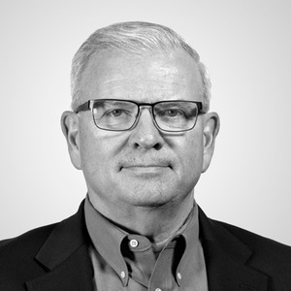
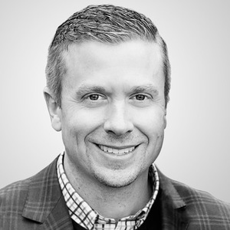
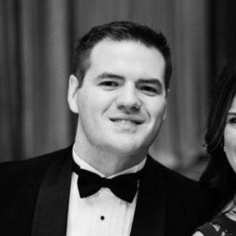
Tonight’s Sponsor
John Owens
John Larson
Steven Warneke
Making project management indispensable for business results.®

Slide 9
Tonight’s Agenda
Registration, Networking/Socializing, Light Snack
5:30-6:15 PM
Business Meeting / Announcements
6:15-6:30 PM
PM Workshop Activities
6:30-7:45 PM
Closing Remarks
7:45-8:00 PM
Making project management indispensable for business results.®

Slide 10
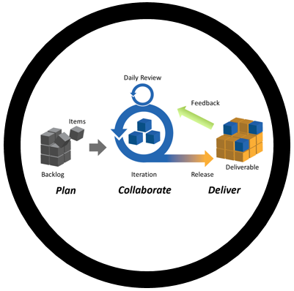
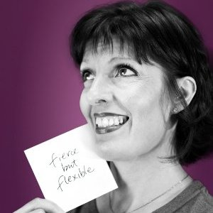
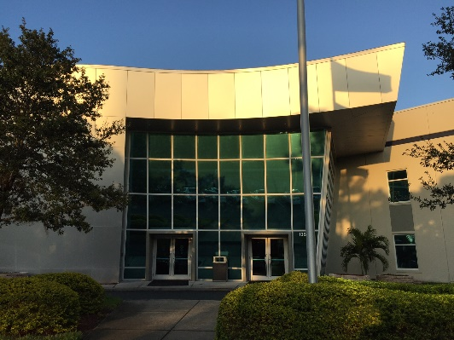


Today’s Meeting
A Different Way to
Meet and Collaborate
May 10th, 2016
Making project management indispensable for business results.®

Slide 11
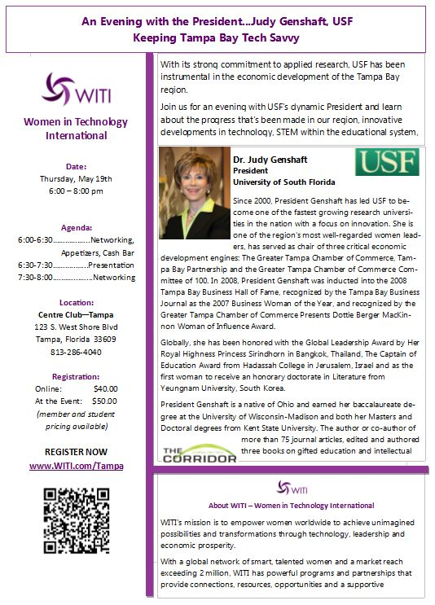
Future Partner Meeting
May 19, 2016
Making project management indispensable for business results.®

Slide 12

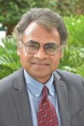
Future Meeting
Big Data Analytics
Not Just For Big Business
June 14, 2016
Dr. Anurag Argarwal
Information Systems Professor
University of South Florida - Sarasota
Making project management indispensable for business results.®

Slide 13

Future Meeting
Making project management indispensable for business results.®

Slide 14

Future Meetings
Across the Bay Networking
July, 2016
Making project management indispensable for business results.®

Slide 15
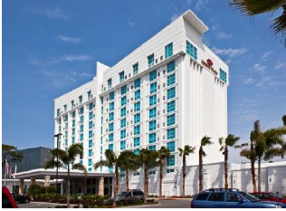
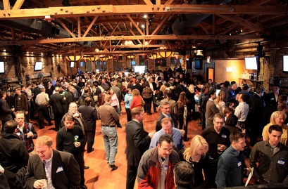
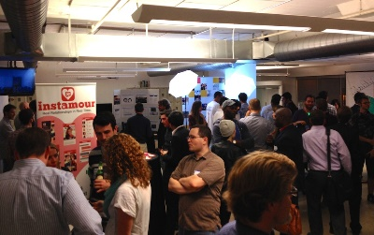

Future Meetings
Women in
Project Management Showcase Event
August 23, 2016
Crowne Plaza Tampa Westshore
5303 W Kennedy Blvd
Tampa, FL 33609
Making project management indispensable for business results.®

Slide 16

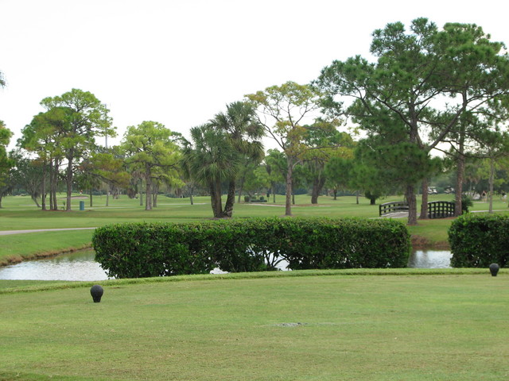
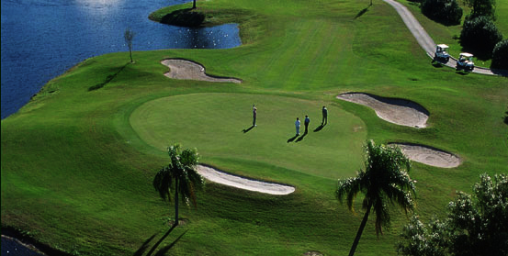
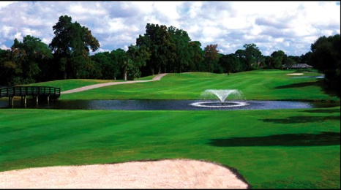
Future Meetings
Golf Outing
August 26, 2016
Making project management indispensable for business results.®

Slide 17








Future Meetings
How to Transition to Project Management and Why You Want To!
October or November, 2016
Making project management indispensable for business results.®

Slide 18

Get Involved!
Consider Volunteering!
Interaction with peers and mentors
Contribute value to PMI Florida Suncoast Chapter
Positive feelings
Sense of accomplishment
Contact Volunteer Leadership Chair Wendy Peacock
Wendy.Peacock@PMI-FloridaSuncoast.org
Making project management indispensable for business results.®

Slide 19

Ideas Welcome
PMI Florida Suncoast Chapter welcomes new ideas on how to find better ways to promote and contribute to the community the field of Project Management.
New Events and Activities
Topics to Consider
Constructive Criticism
Contact President Bill Wagner
William.Wagner@PMI-FloridaSuncoast.org
Making project management indispensable for business results.®

