Slide 1

December 9, 2015
2016 Preview

Slide 2

Why ?

Slide 3
Why ?
Vision
Local leadership and management embracing the PMI principles, values, and certifications as key components in organizational and individual success in the field of project management.
Mission
The Florida Suncoast PMI Chapter leads the local community in the advancement in the field of project management by promoting the PMI’s values and principles, as well as by organizing and facilitating initiatives, events, and activities to support individuals and organizations.

Slide 4
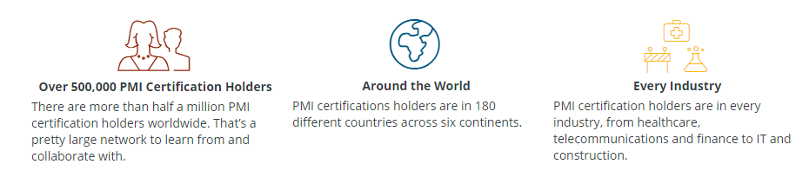
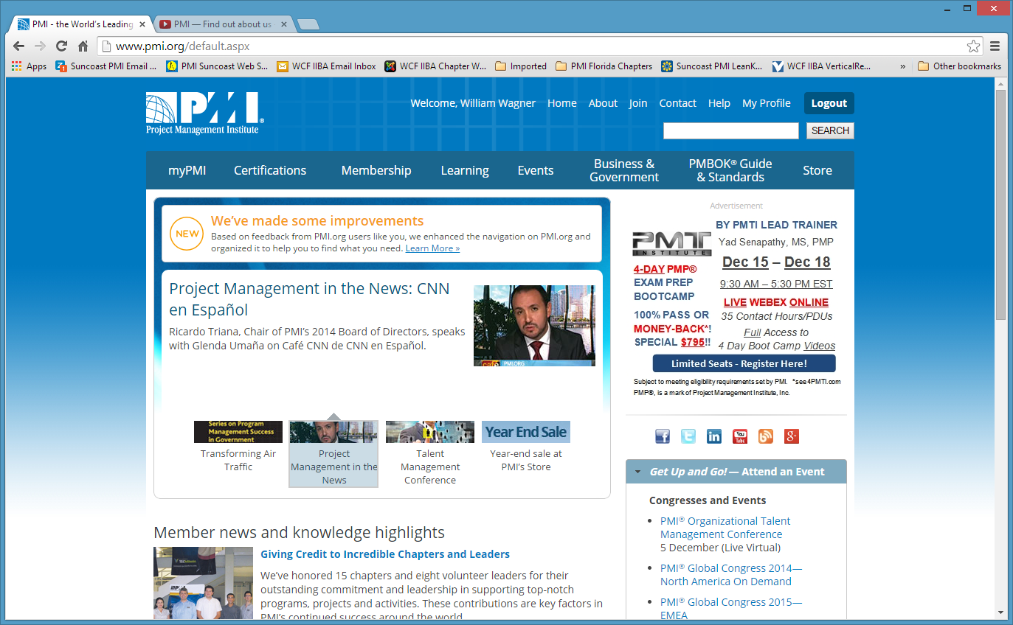
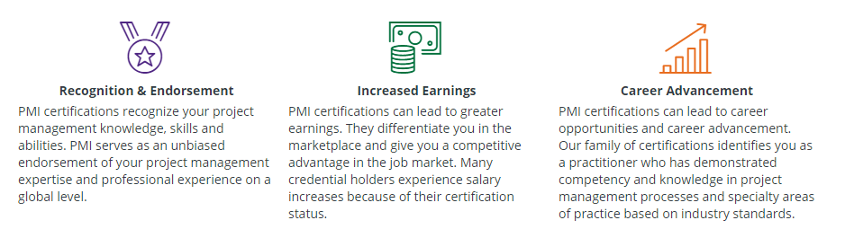








Why ?

Slide 5
Why ?
Certification Prep Classes
PMP® Exam Prep Classes
PMI-ACP Exam Prep Classes
PMI-PBA Exam Prep Classes

Slide 6
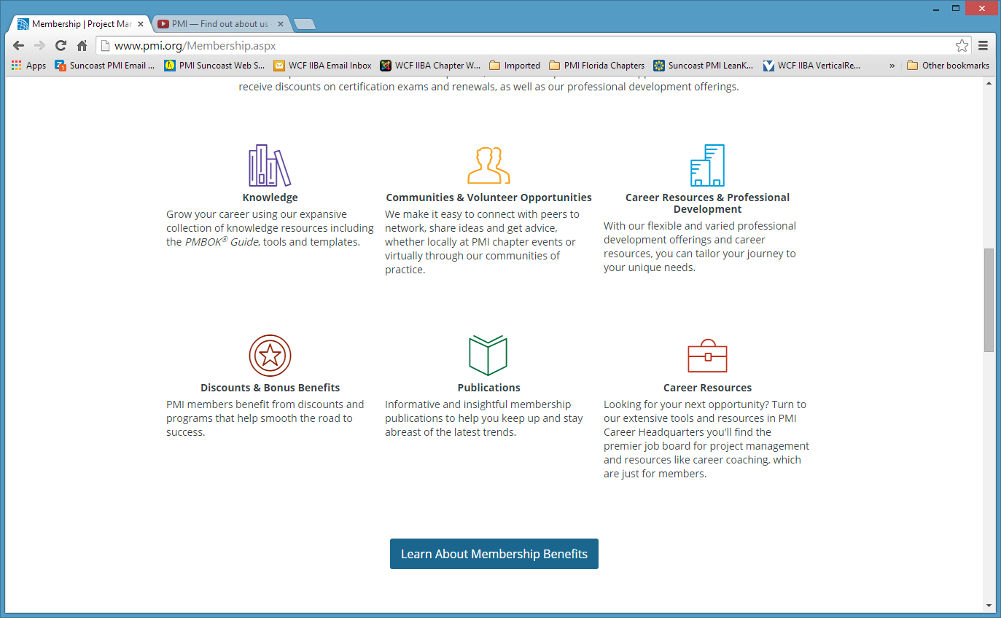
Why ?

Slide 7
Why ?
Orientation Meetings
Orientation meetings provide the opportunity for members and prospective members to learn about what the PMI Florida Suncoast Chapter provides.
Joint Events
Cross-pollination of other local professional organizations provides the foundation for finding others who are like-minded and interested in participating in events and activities that foster new and exciting relationships.

Slide 8
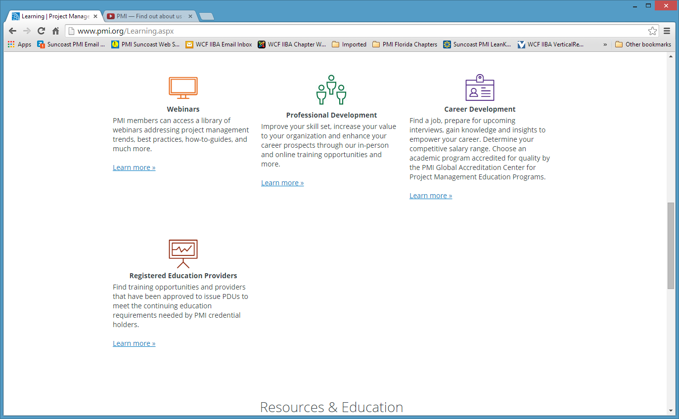
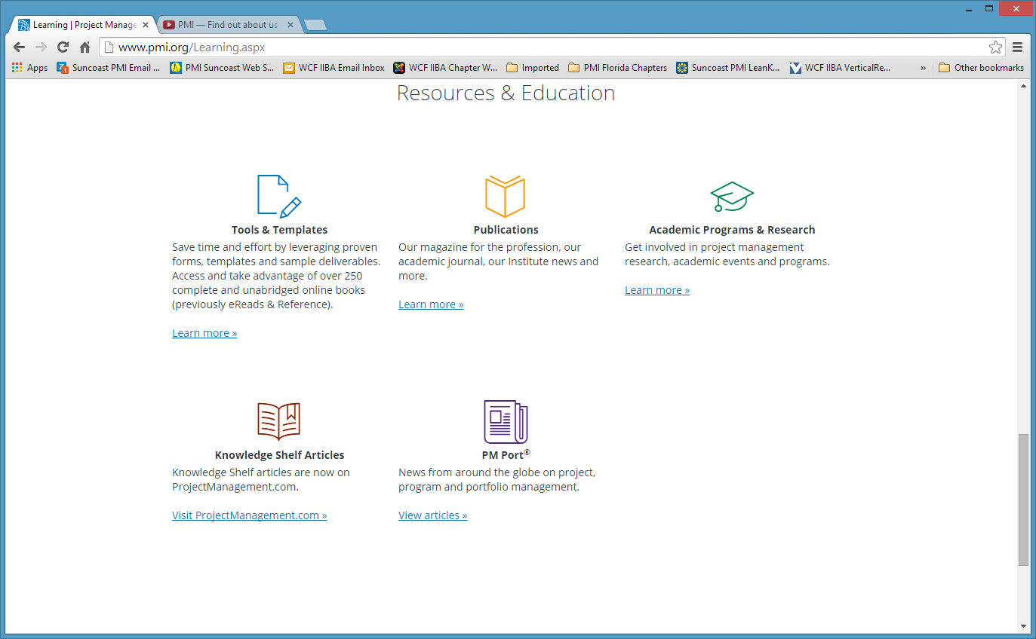
Why ?
Pulse of the Profession®
Thought Leadership

Slide 9
Why ?
Chapter Meetings
Chapter meetings provide the opportunity for members and non-members to network with others who are interested in the field of project management, be educated and entertained by speakers who are interested in presenting a topic of interest for members and non-members, and for certified members to earn PDUs towards their recertification
Networking Events
Networking meetings provide the opportunity for members and non-members to meet new people with like-minded interests, particularly in the field of project management, as well as the opportunity for certified members to earn PDUs towards their recertification. Networking meetings also provide the opportunity for recruiters to meet members and non-members who may be looking for new and better jobs, as well as an opportunity for companies who are looking for new and better project management talent.

Slide 10
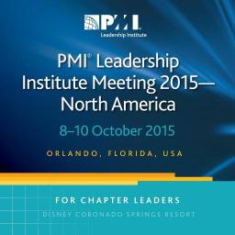










Why ?

Slide 11
Why ?
Represent Florida Suncoast
2016 PMI Region 14 Leadership Conference
in Lowlands, Tobago
2016 PMI Leadership Institute Meeting-North America
in San Diego, California
2016 PMI Mega SeminarsWorld
in Orlando, Florida

Slide 12
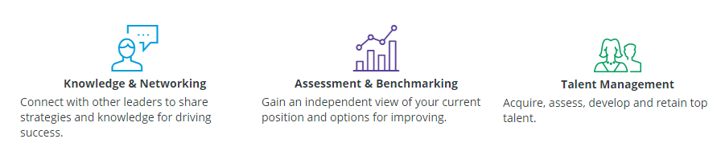
Why ?

Slide 13
Why ?
Certification Prep Classes
PMP-Prep Classes - ACP-Prep Classes
Community Outreach
Military Liaison Program
Academic Outreach Program
Volunteering Opportunities
Contribute to and shape the future of the profession
Manage local PMI chapters and online communities
Influence the profession by writing and publishing
Help younger professionals build experience and grow
Represent Florida Suncoast
PMI Region 14 Leadership Conference
PMI Leadership Institute Meeting-North America
PMI Mega SeminarsWorld

Slide 14
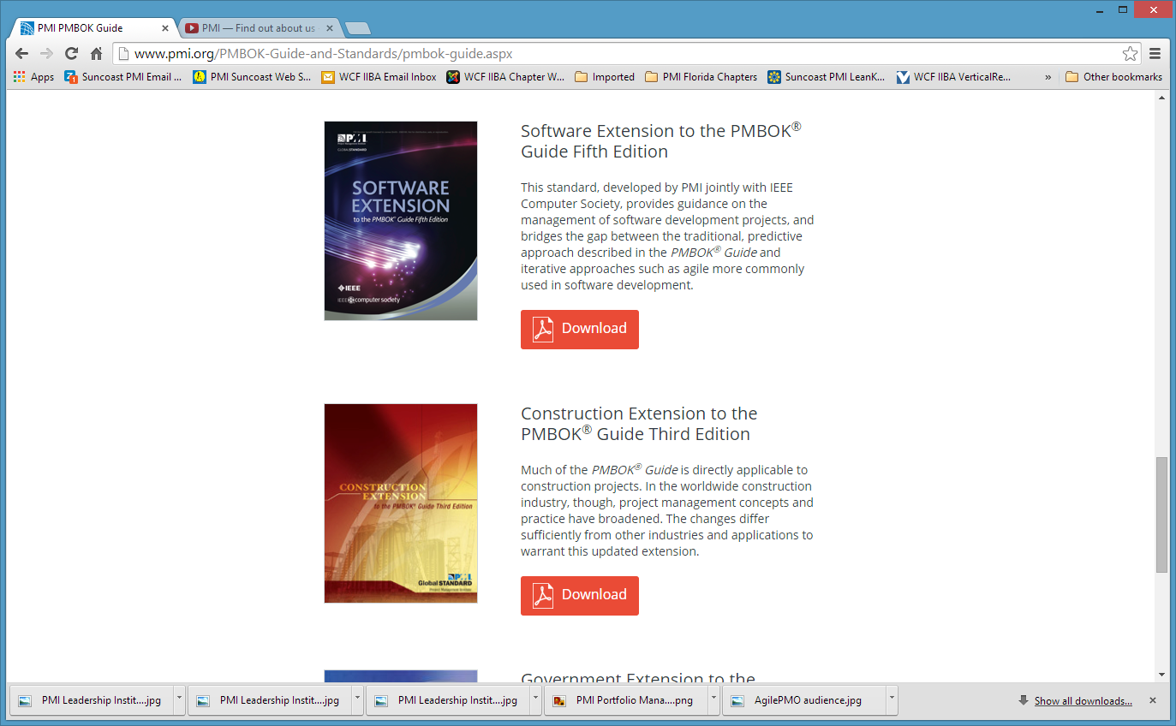
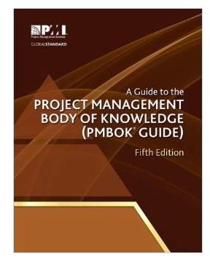
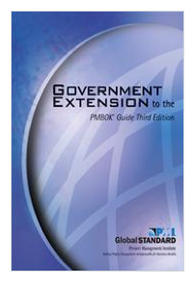
Why ?

Slide 15
Why ?
Certification Prep Classes
PMP-Prep Classes - ACP-Prep Classes
Community Outreach
Military Liaison Program
Academic Outreach Program
Volunteering Opportunities
Contribute to and shape the future of the profession
Manage local PMI chapters and online communities
Influence the profession by writing and publishing
Help younger professionals build experience and grow
Represent Florida Suncoast
PMI Region 14 Leadership Conference
PMI Leadership Institute Meeting-North America
PMI Mega SeminarsWorld

Slide 16
What did do in 2015?
Chapter Meetings
Over 300 attendees in 9 chapter meetings in 2014

Slide 17

Why ?
Initiatives
Agile Project Management

Slide 18
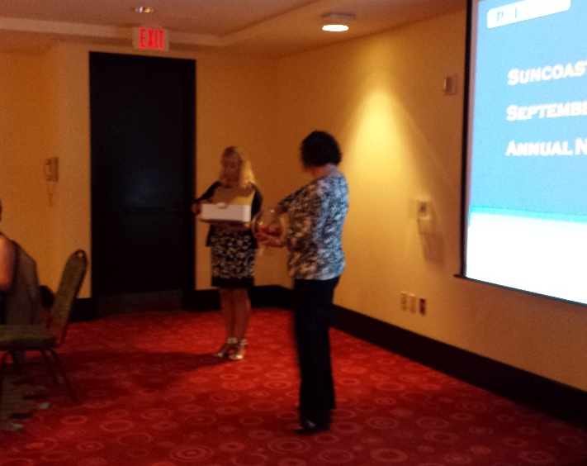
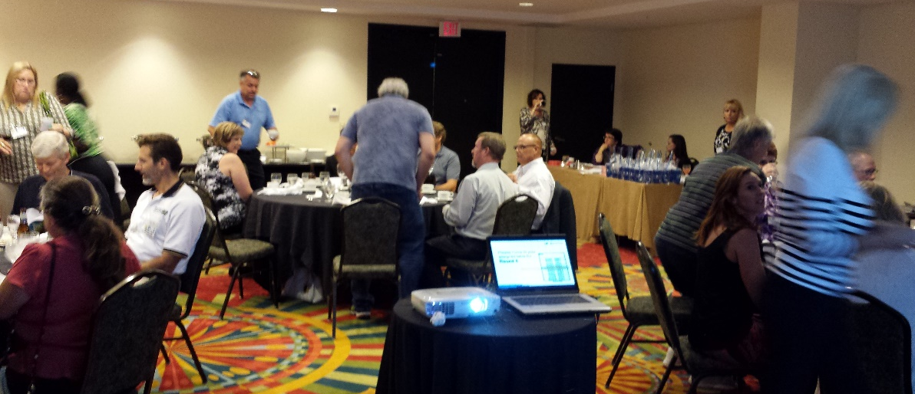
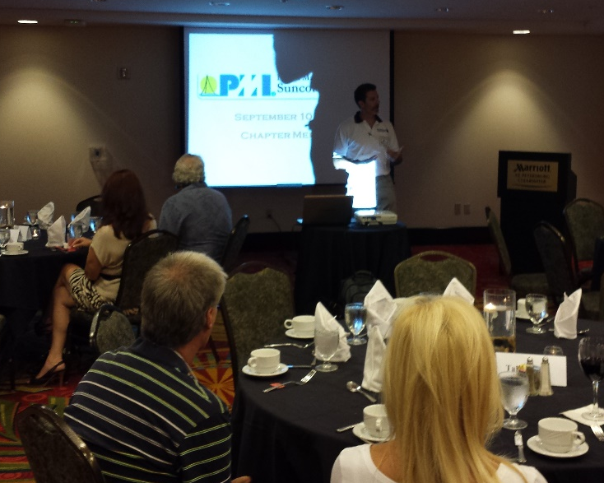
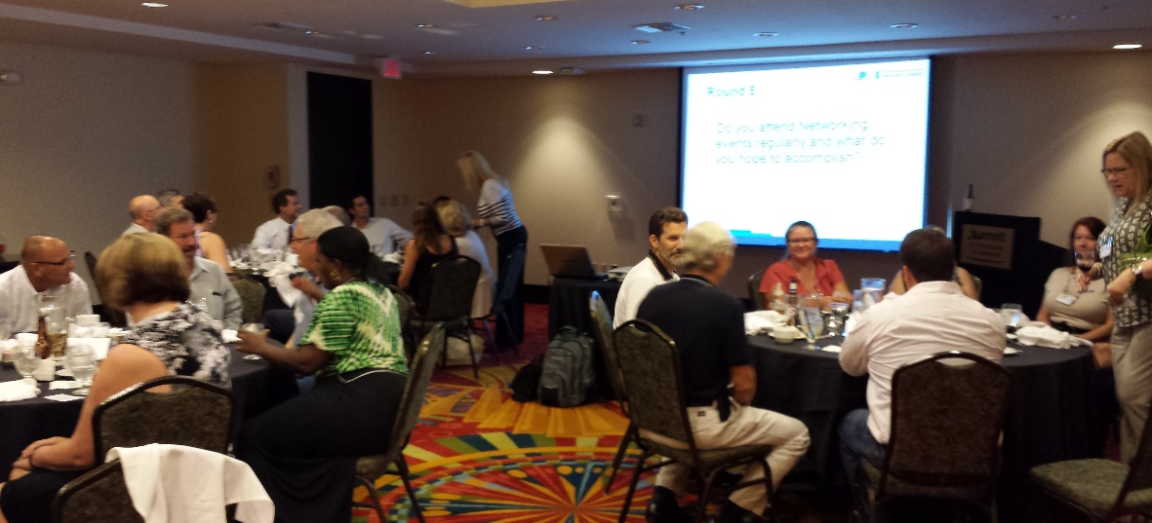

Why ?
Networking Events
Another Speed Networking in 2015

Slide 19


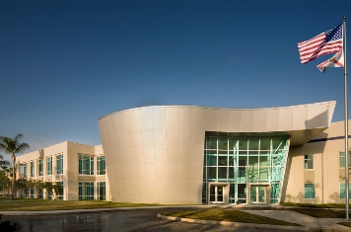
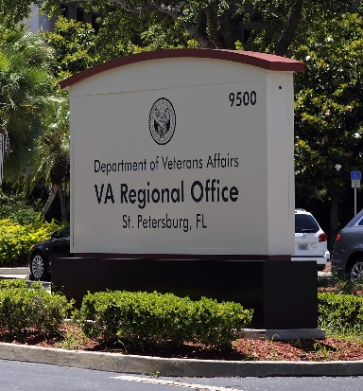



Why ?
Community Outreach
Academic Outreach Program
Military Liaison Program
Business Organizations

Slide 20
Why ?
Volunteering Opportunities
Organize, Market/Promote, and Coordinate Chapter Meetings and Special Events
Manage Community Outreach Programs
Organize, Market/Promote, and Coordinate Exam-Prep Classes
Find Sponsors for Local Events

Slide 21
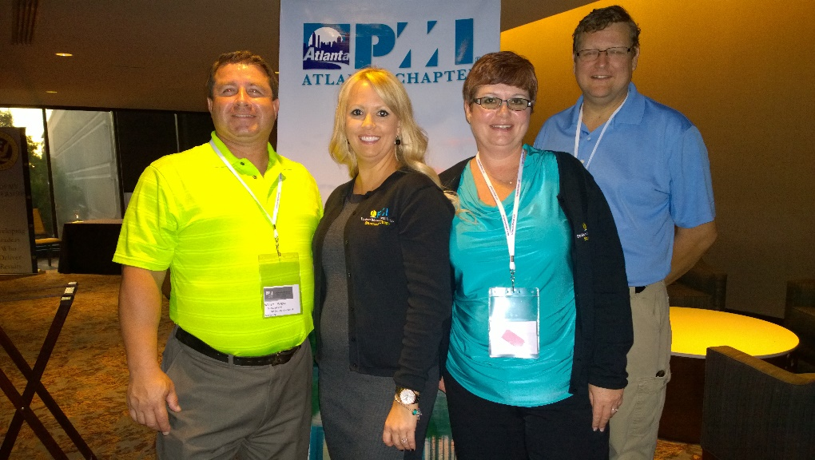
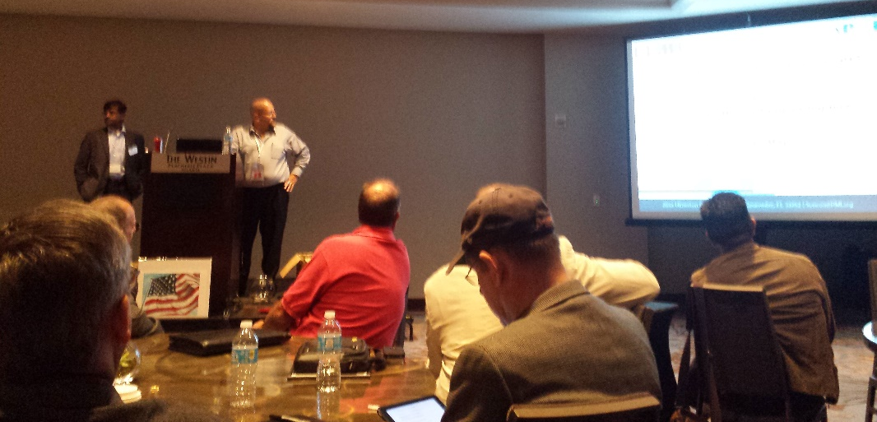
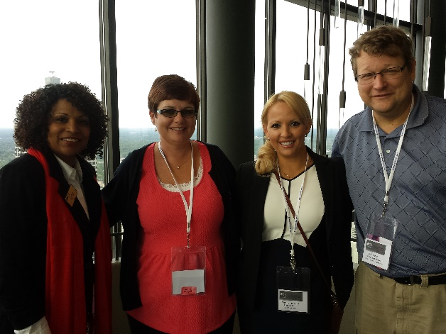
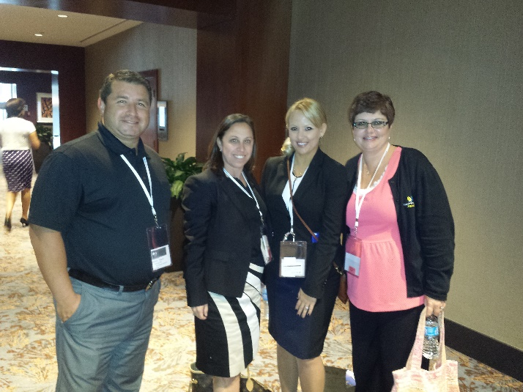
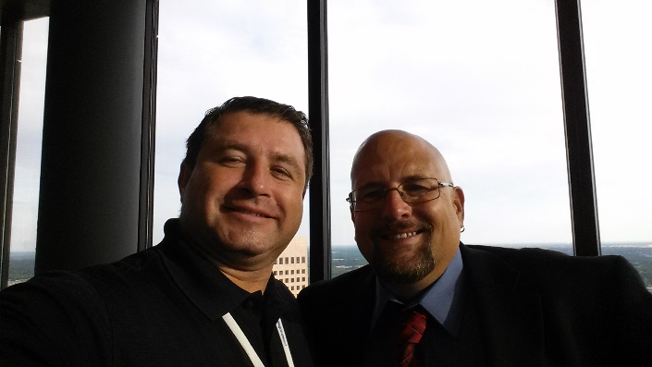
Why ?
Represent Florida Suncoast
2015 PMI Region 14 Leadership Conference
Comradery

Slide 22
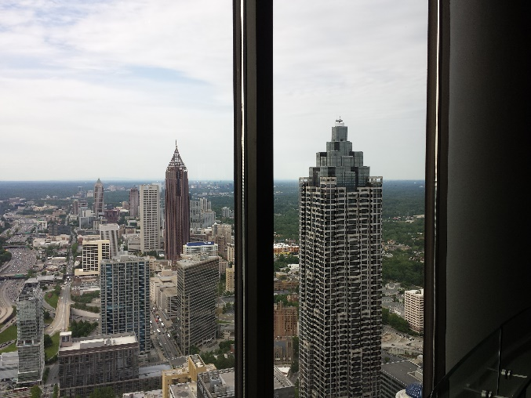
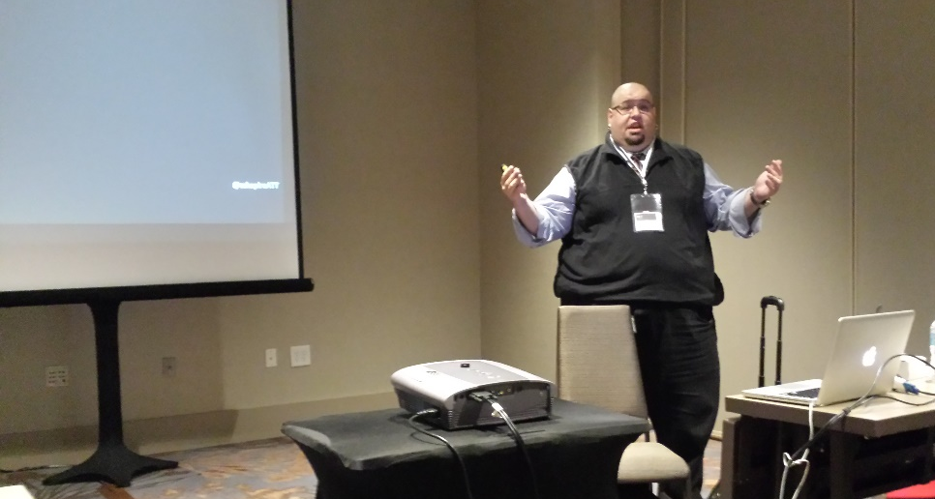
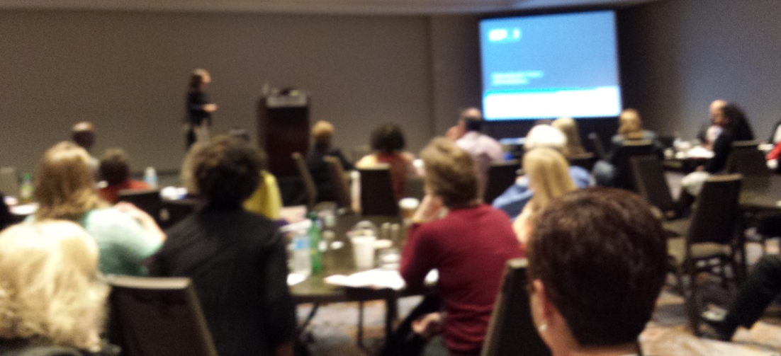
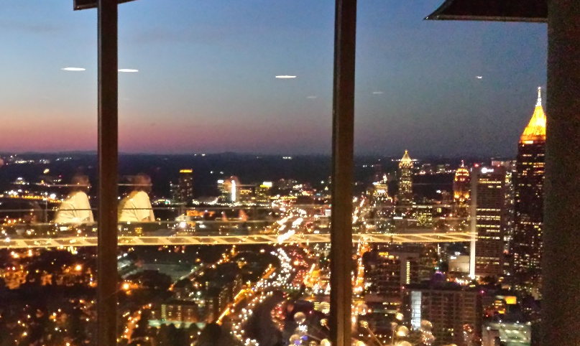
Why ?
Represent Florida Suncoast
2015 PMI Region 14 Leadership Conference
Morning to Night – Learning and Sharing

Slide 23
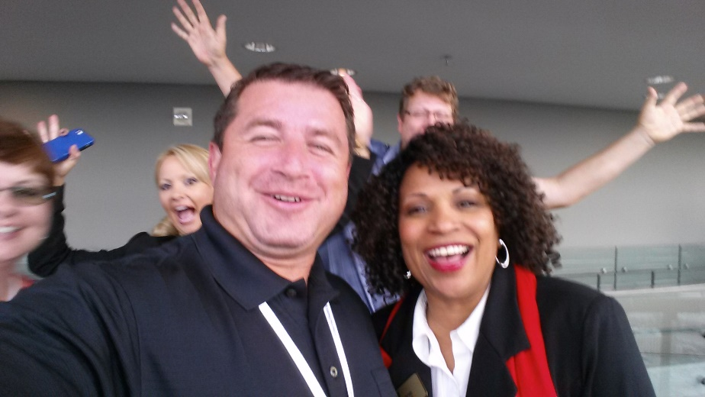
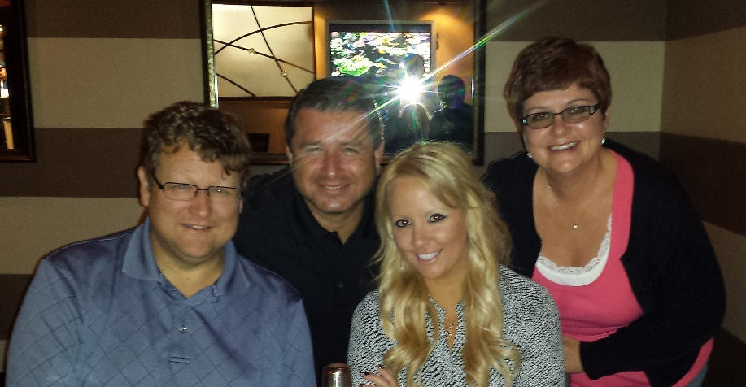
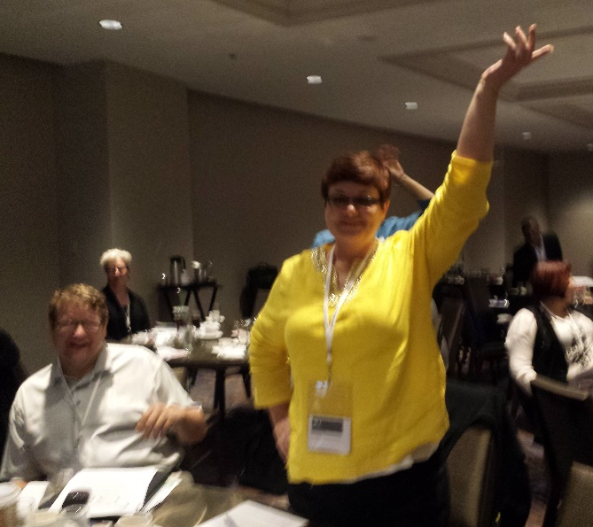
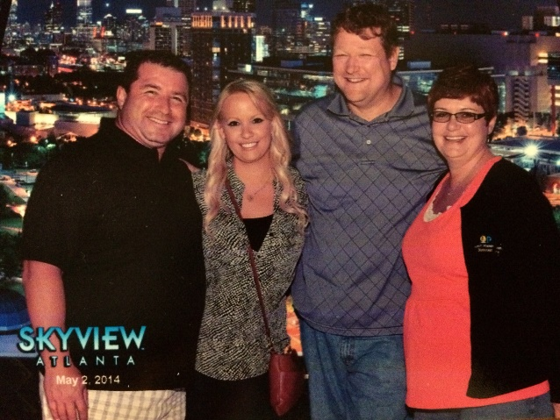

Why ?
Represent Florida Suncoast
2015 PMI Region 14 Leadership Conference
Meeting New People and Experiencing New Things

Slide 24

Why ?
Represent Florida Suncoast

Slide 25
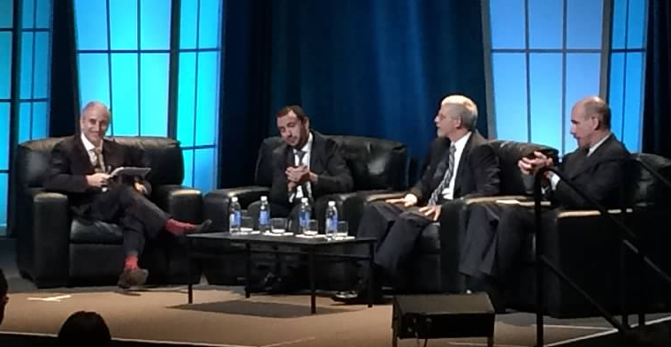
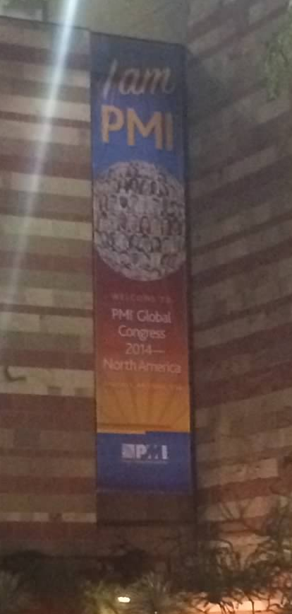
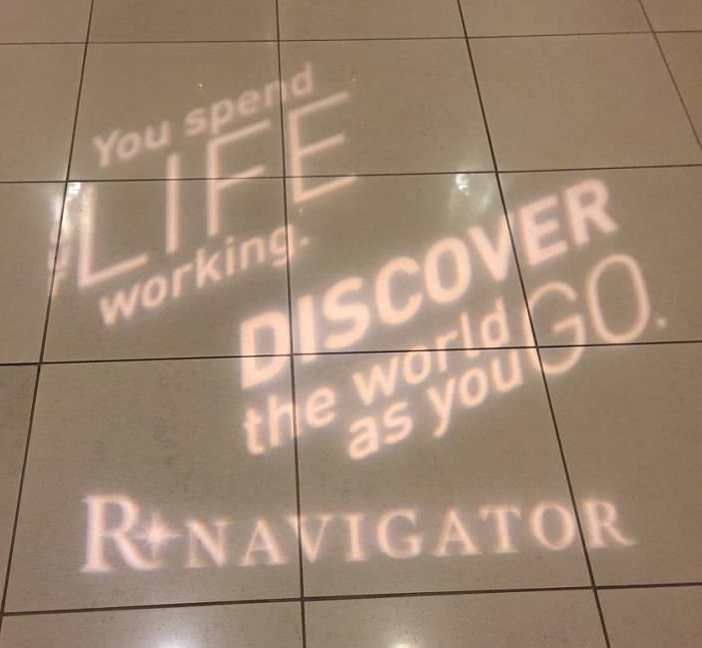
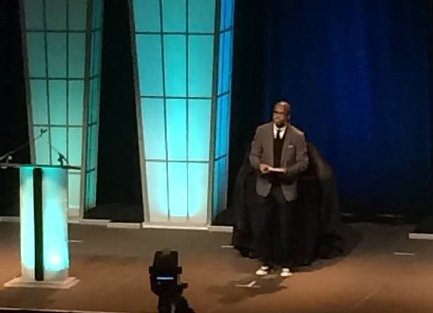
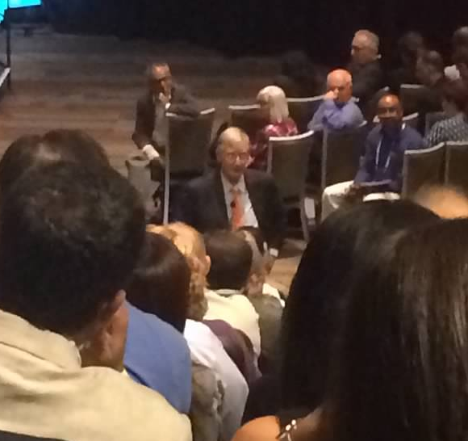
Why ?
Represent Florida Suncoast
PMI Keynote Speakers and Leadership Discussions

Slide 26
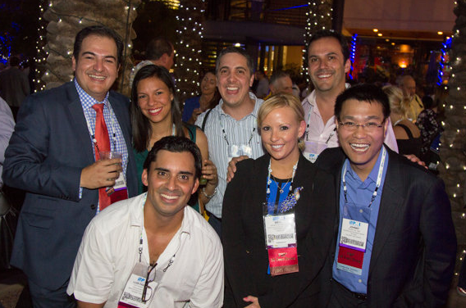
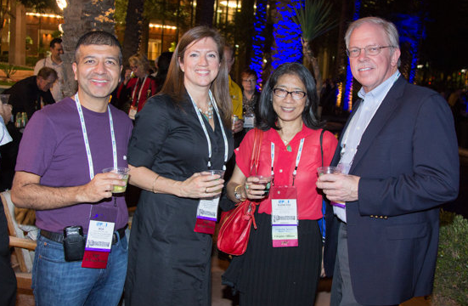
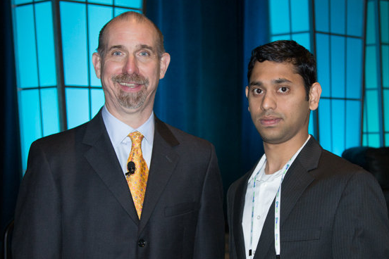
Why ?
Represent Florida Suncoast
2014 PMI Leadership Institute Meeting in Phoenix
Meeting People from All Over

Slide 27
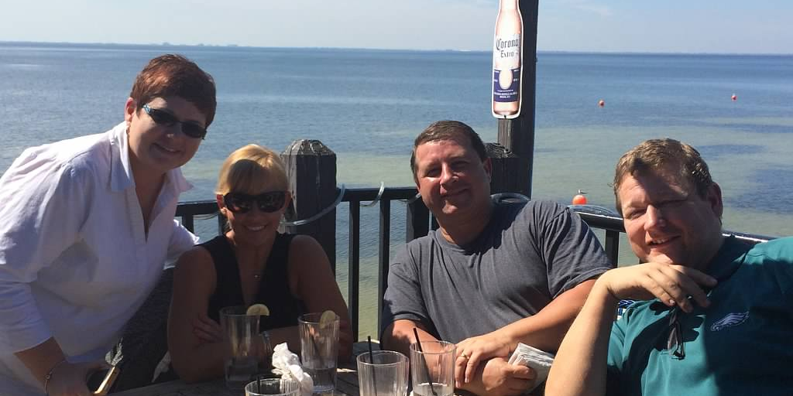
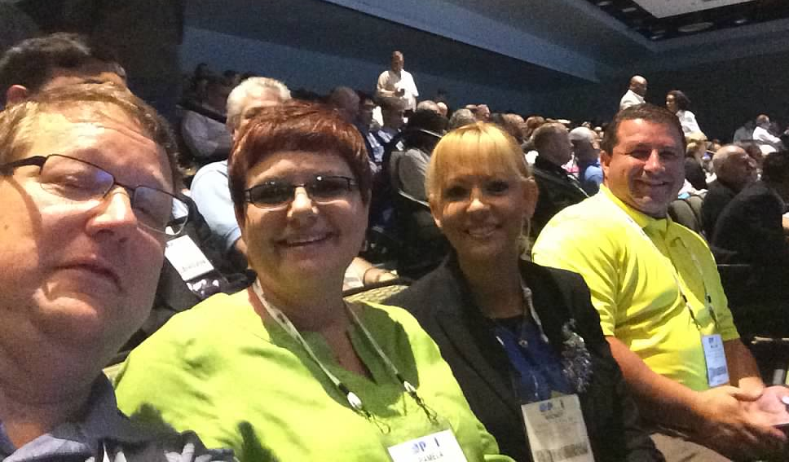
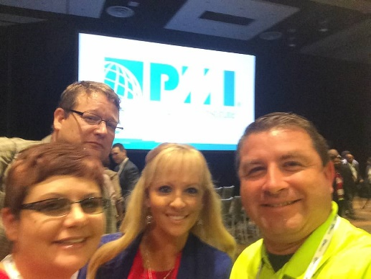
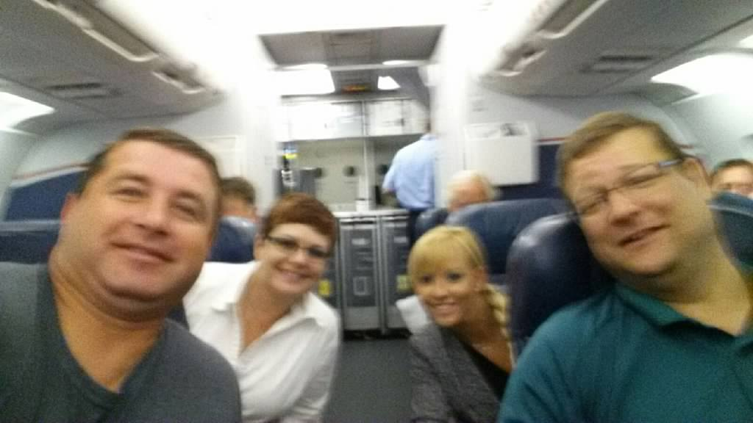
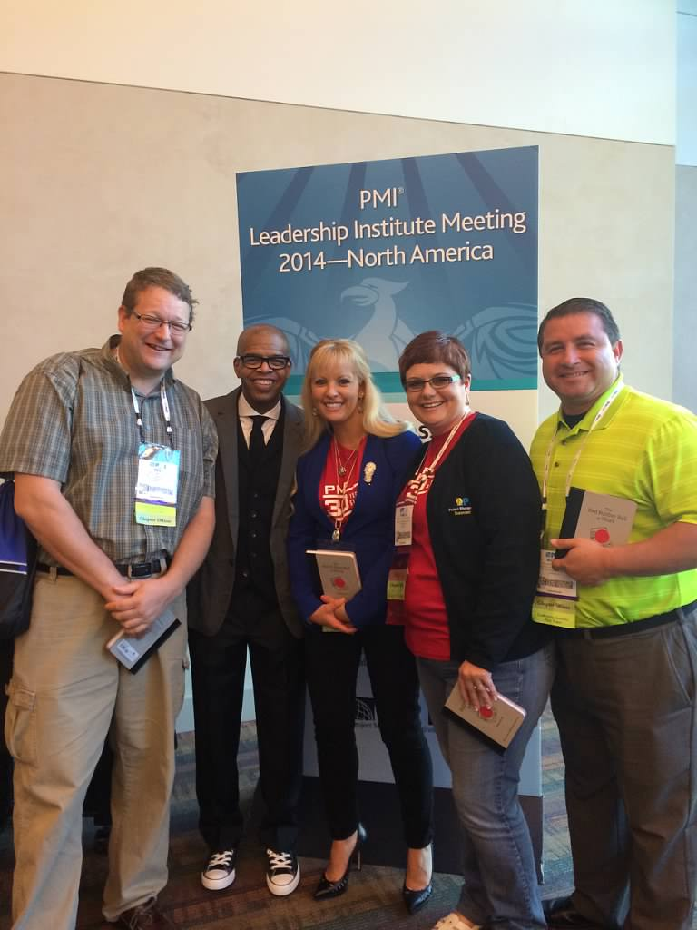
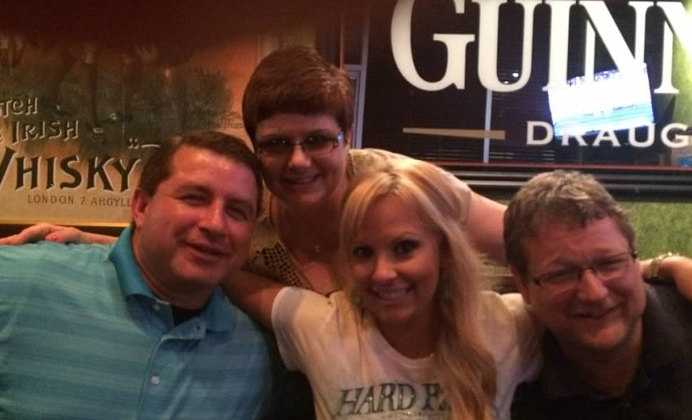
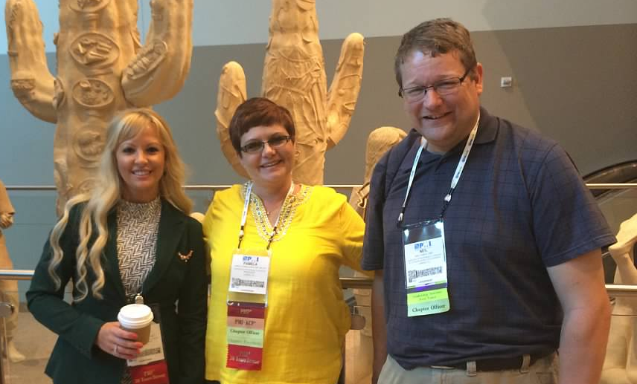
Why ?
Represent Florida Suncoast
2015 PMI Leadership Institute Meeting in Orlando
Comradery

Slide 28
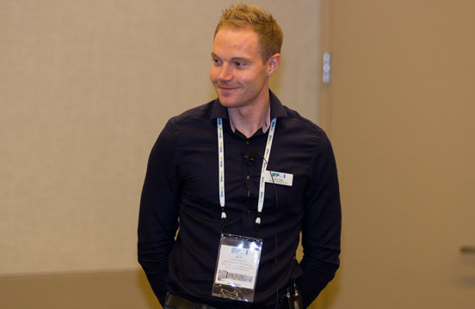
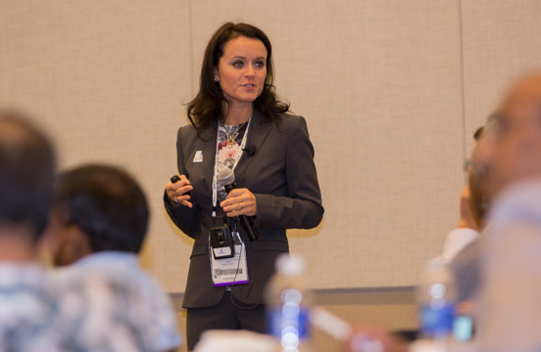
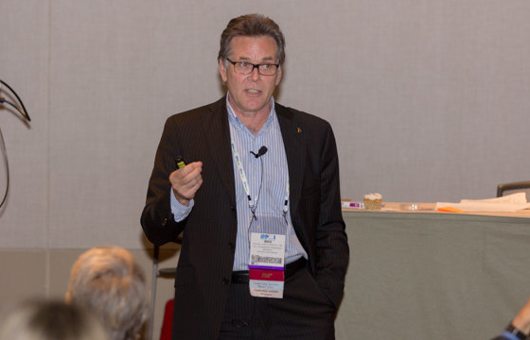
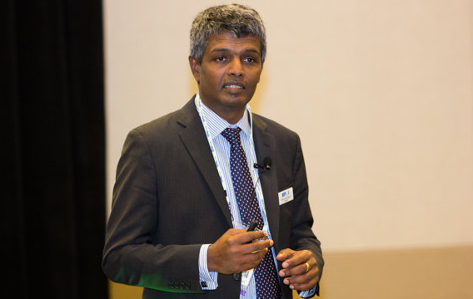
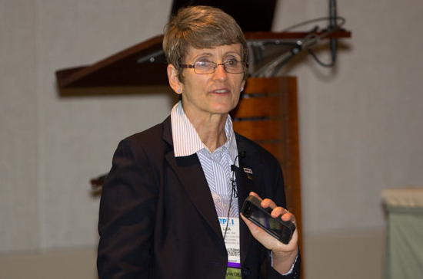








Why ?
Represent Florida Suncoast
2015 PMI Leadership Institute Meeting in Orlando
Amazing Presenters and Sharing

Slide 29

For a great 2015

