Slide 1

December 9, 2015
Year in Review

Slide 2
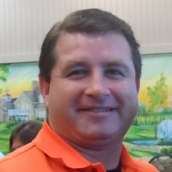
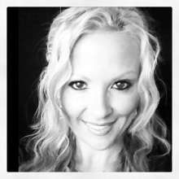
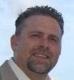
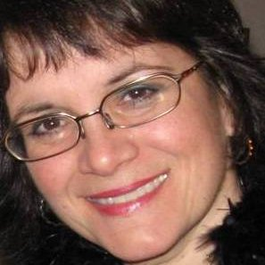
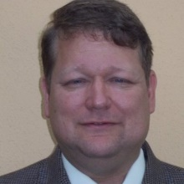

Starring
Bill Wagner
as President
Wendy Peacock
as Past-President
Frank Coleman
as VP of Finance
Janine Traycheff
as VP of Administration
Neil Kimes
as VP of Professional Development
Danita Downey
as Member At Large

Slide 3
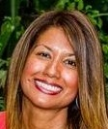
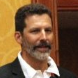
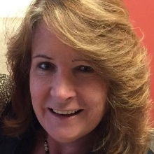
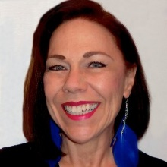
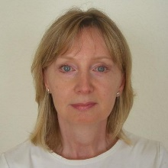
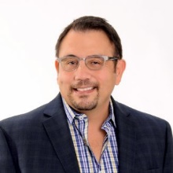
Also Starring
Gerald Lowe
Leila Castellanos
as VP of Membership
as VP of Membership
Carolyn Shope
as VP of Marketing
Catalina McChesney
as VP of Communications
Annemarie Wolfe
as VP of Technology & eCommerce
Anthony Aguilar
as VP of Special Projects

Slide 4

Why ?

Slide 5
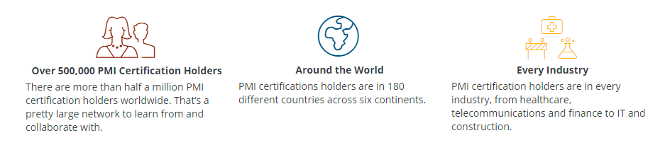
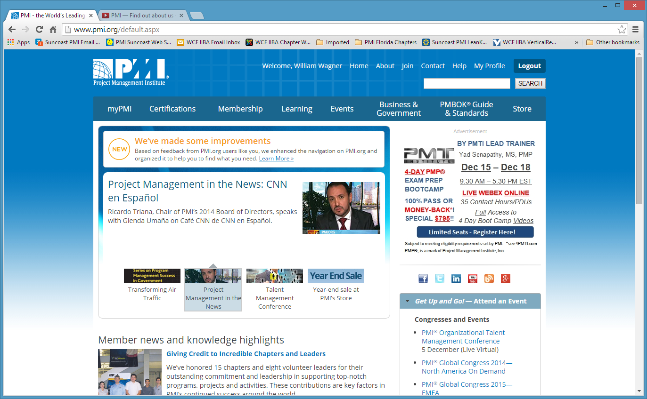
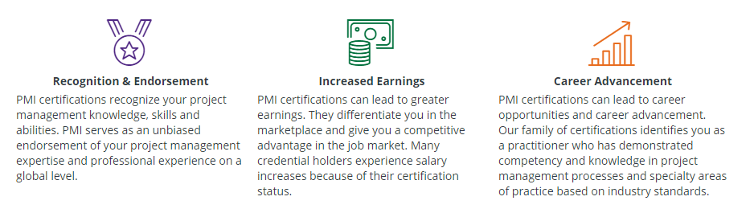








Why ?

Slide 6
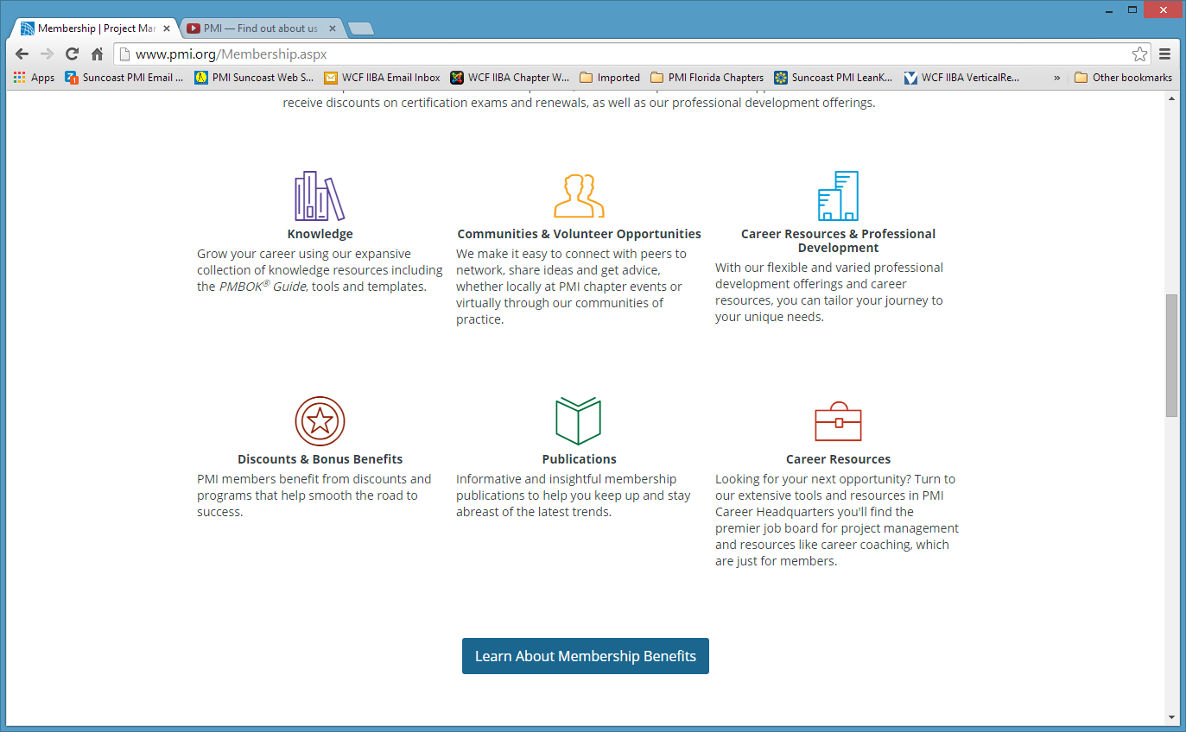
Why ?

Slide 7
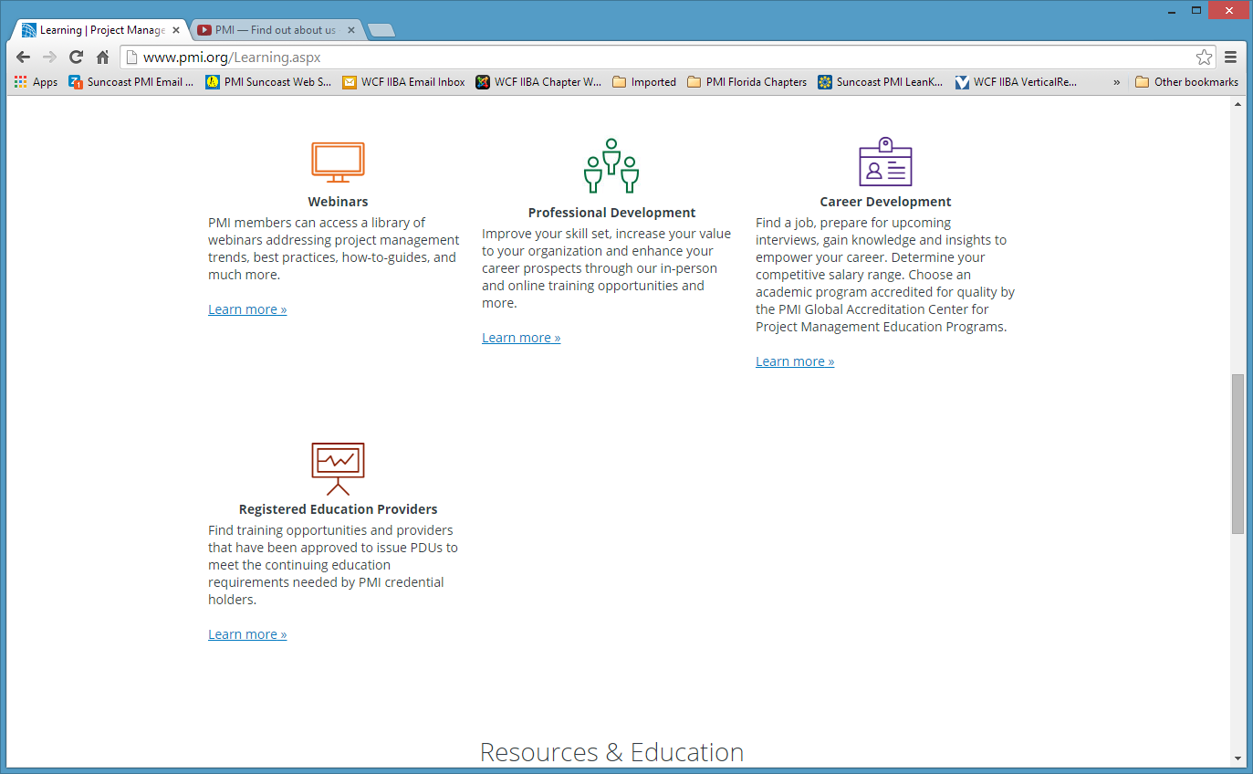
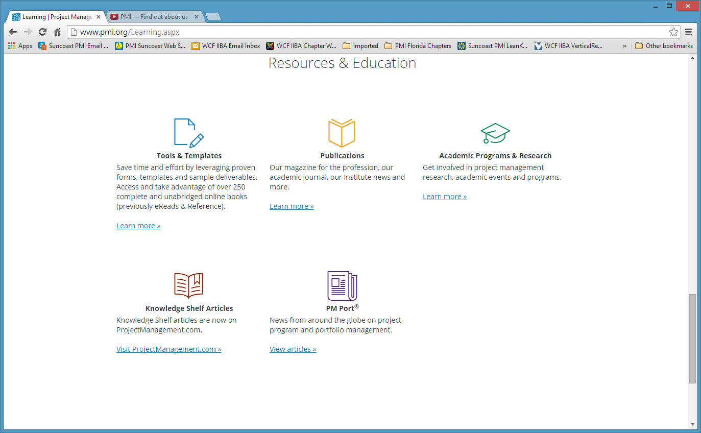
Why ?
Pulse of the Profession®
Thought Leadership

Slide 8
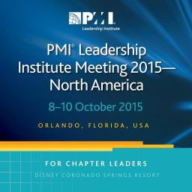










Why ?

Slide 9
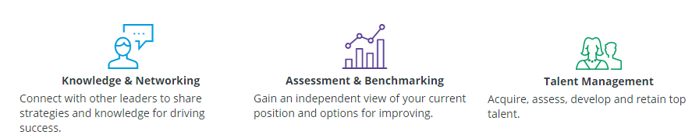
Why ?

Slide 10
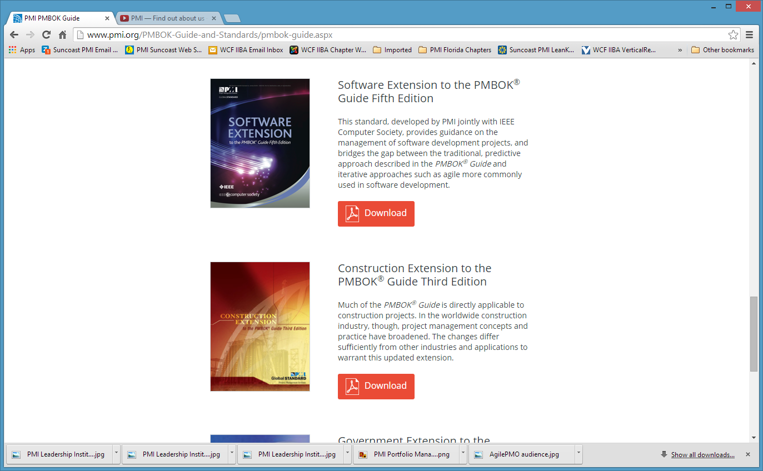
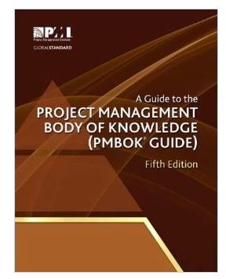
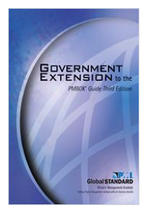
Why ?

Slide 11
Why ?
Vision
Local leadership and management embracing the PMI principles, values, and certifications as key components in organizational and individual success in the field of project management.
Mission
The PMI Florida Suncoast Chapter leads the local community in the advancement in the field of project management by promoting the PMI’s values and principles, as well as by organizing and facilitating initiatives, events, and activities to support individuals and organizations.

Slide 12
Why ?
Chapter Meetings
Chapter meetings provide the opportunity for members and non-members to network with others who are interested in the field of project management, be educated and entertained by speakers who are interested in presenting a topic of interest for members and non-members, and for certified members to earn PDUs towards their recertification
Networking Events
Networking meetings provide the opportunity for members and non-members to meet new people with like-minded interests, particularly in the field of project management, as well as the opportunity for certified members to earn PDUs towards their recertification. Networking meetings also provide the opportunity for recruiters to meet members and non-members who may be looking for new and better jobs, as well as an opportunity for companies who are looking for new and better project management talent.

Slide 13
Why ?
Certification Prep Classes
PMP-Prep Classes - ACP-Prep Classes
Community Outreach
Military Liaison Program
Academic Outreach Program
Volunteering Opportunities
Contribute to and shape the future of the profession
Manage local PMI chapters and online communities
Influence the profession by writing and publishing
Help younger professionals build experience and grow
Represent Florida Suncoast
PMI Region 14 Leadership Conference
PMI Leadership Institute Meeting-North America
PMI Mega SeminarsWorld

Slide 14
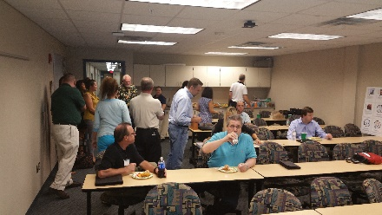
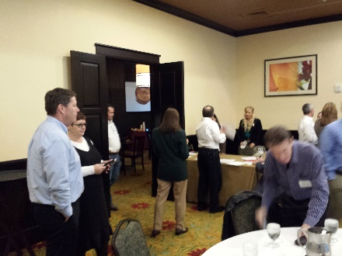
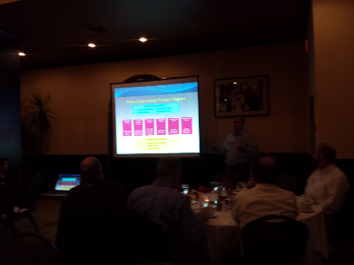
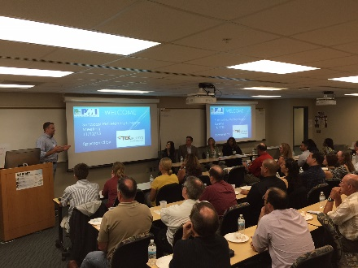
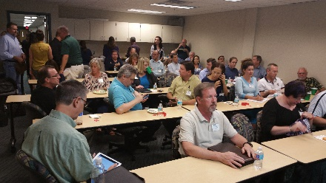
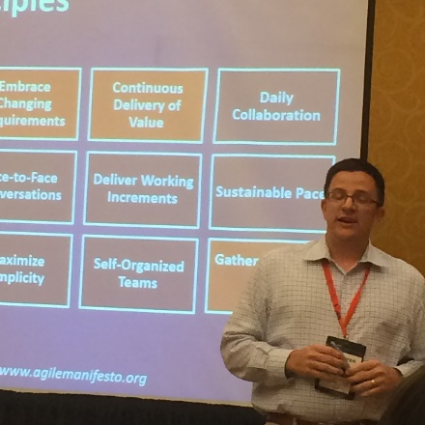
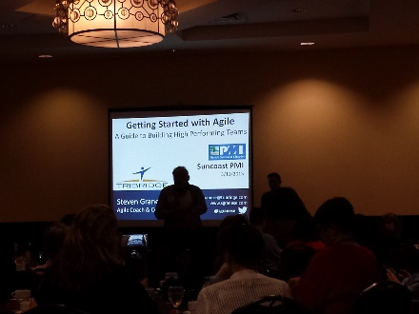
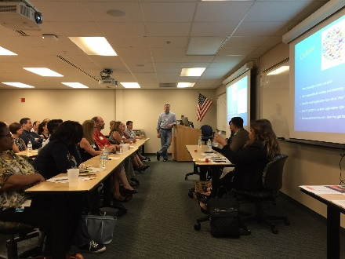
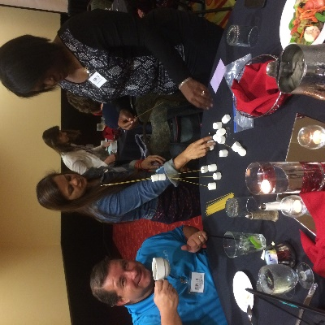
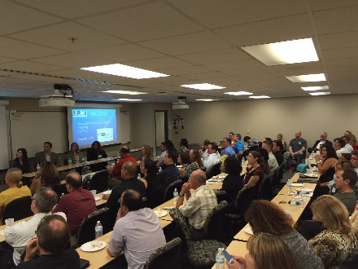
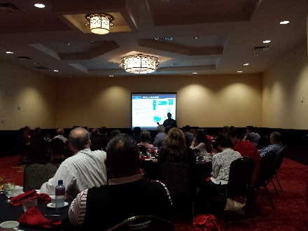
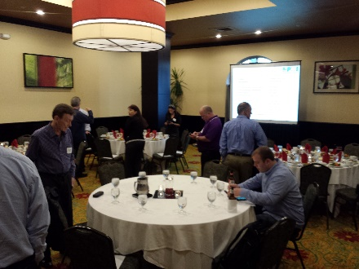
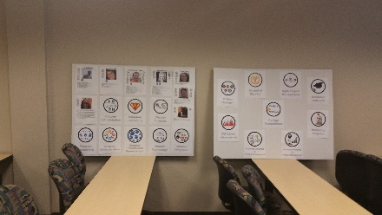
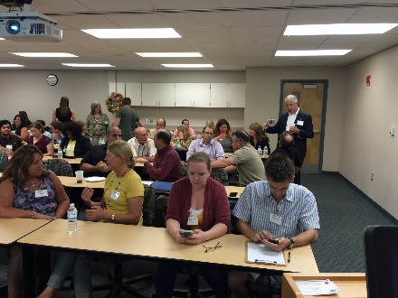
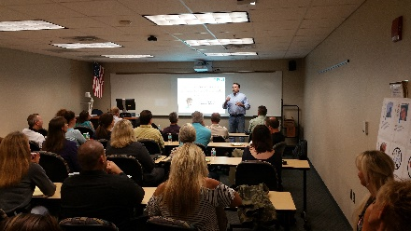

What did do in 2015?
Chapter Meetings
Over 300 attendees in 8 chapter meetings in 2015

Slide 15

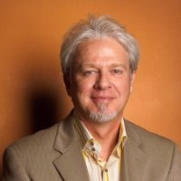

Why ?
Chapter Meetings
Art at Work
Michael Lehman
Design Integration, Project Management and Return on Investment

Slide 16
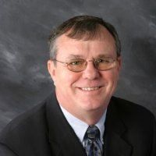

Why ?
Chapter Meetings
Value Engineering
Don H. Stafford
What is true Value Engineering?
How and when to apply Value Engineering?
Examples of Value Engineering

Slide 17
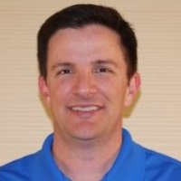

Why ?
Chapter Meetings
Getting Started with Agile
Steven Granese
PMI-ACP, CSP, CSM
How to Build High Performing Teams

Slide 18
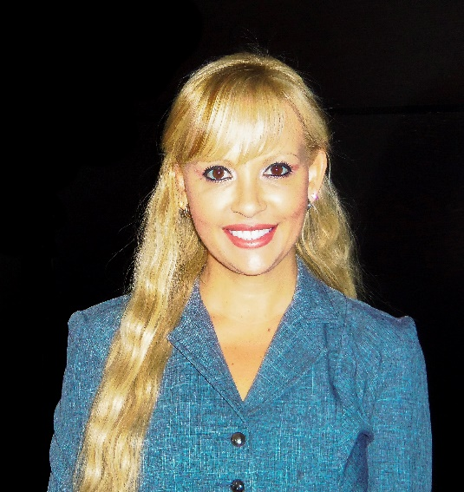
Why ?
Chapter Meetings
Make the Shift
Wendy Peacock
PMP, PMI-ACP
Project Management
To Project Leadership

Slide 19

Why ?
Chapter Meetings
What’s New with MS Project Server and the Cloud
Jeff Collins

Slide 20


Why ?
Chapter Meetings
Brand/Career Management
Fritz Eichelberger

Slide 21
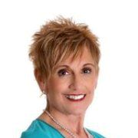

Why ?
Chapter Meetings
What’s all the hype about LinkedIn? And WHY should you care?
Sherry Sexton
Queen of

Slide 22
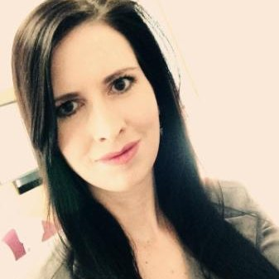
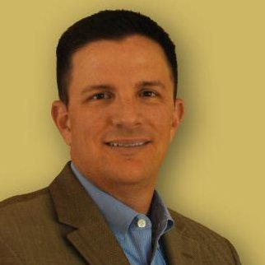
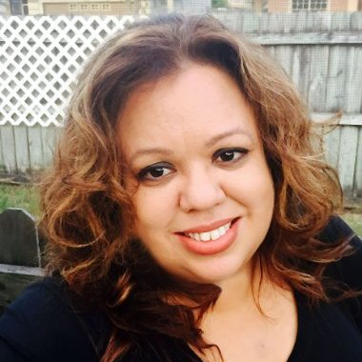
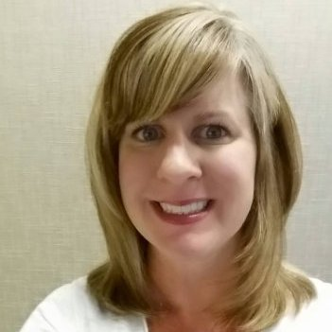





Why ?
Chapter Meetings
Agile Panel Discussion
Stephanie Davis
Steven Granese
Cristina Liriano
Monica Murphy

Slide 23
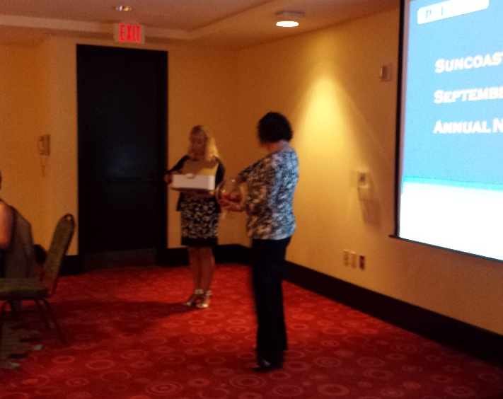
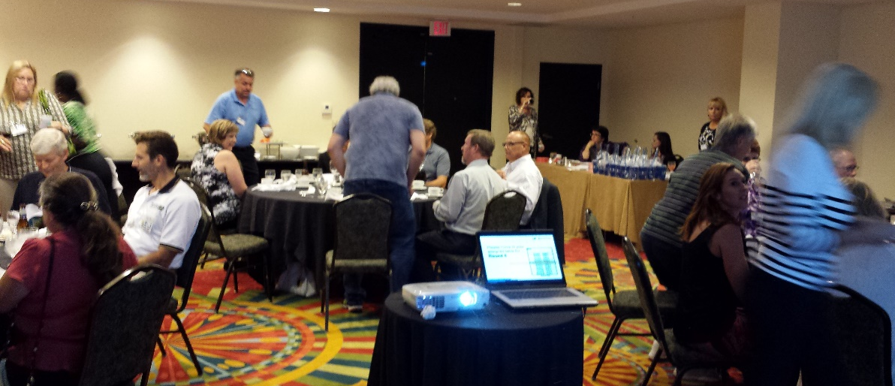
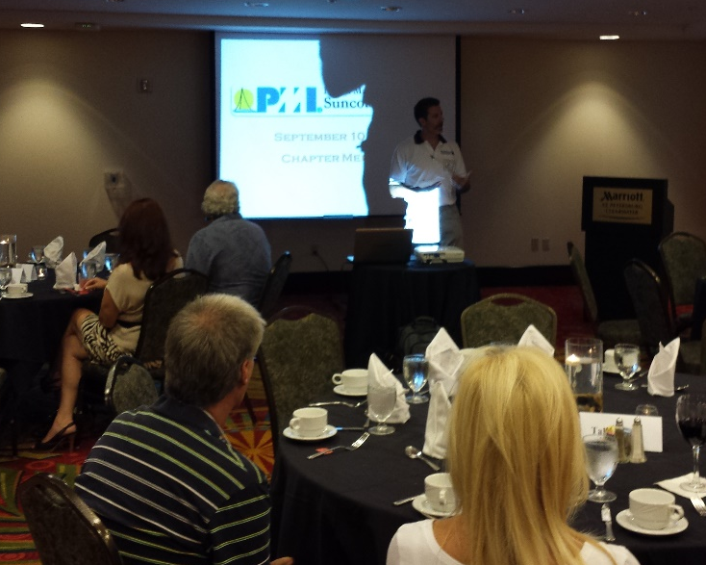
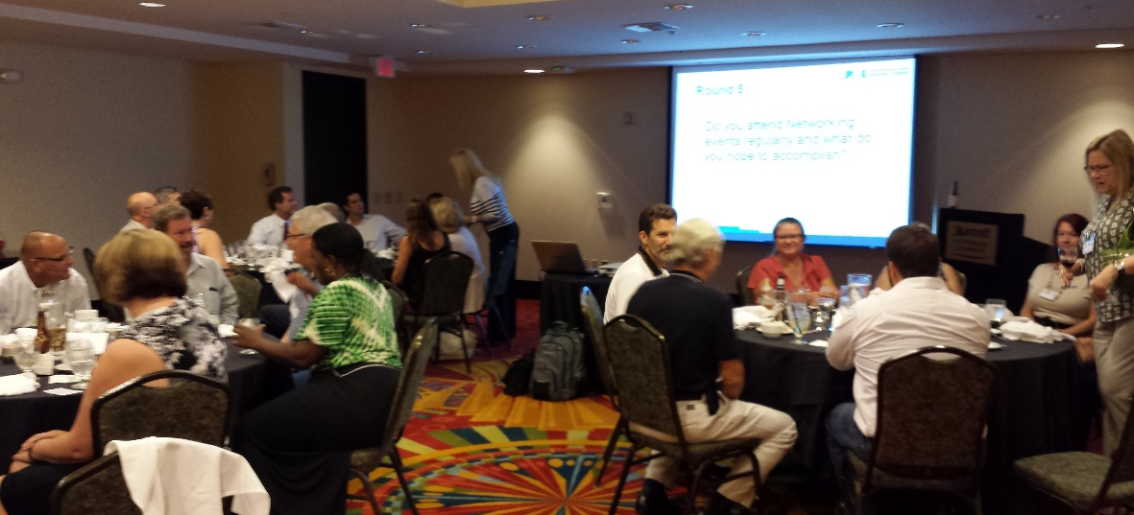
Why ?
Networking Event
Another Speed Networking in 2015

Slide 24







Why ?
Community Outreach
Academic Outreach Program
Military Liaison Program
Business Organizations

Slide 25
Why ?
Volunteering Opportunities
Organize, Market/Promote, and Coordinate Chapter Meetings and Special Events
Manage Community Outreach Programs
Organize, Market/Promote, and Coordinate Exam-Prep Classes
Find Sponsors for Local Events

Slide 26






Why ?
Represent Florida Suncoast
2015 PMI Region 14 Leadership Conference
Comradery

Slide 27















Why ?
Represent Florida Suncoast
2015 PMI Region 14 Leadership Conference
Morning to Night – Learning and Sharing

Slide 28







Why ?
Represent Florida Suncoast
2015 PMI Region 14 Leadership Conference
Meeting New People and Experiencing New Things

Slide 29
Why ?
Represent Florida Suncoast

Slide 30









Why ?
Represent Florida Suncoast
PMI Keynote Speakers and Leadership Discussions

Slide 31






Why ?
Represent Florida Suncoast
2015 PMI Leadership Institute Meeting in Orlando
Meeting People from All Over

Slide 32






Why ?
Represent Florida Suncoast
2015 PMI Leadership Institute Meeting in Orlando
Amazing Presenters and Sharing

Slide 33

For a great 2015

